Slide 1
Unity & Resolving Misunderstanding
Joshua 22:10-34

Slide 2
Joshua 22:10-34
¹⁰ When they came to Geliloth near the Jordan in the land of Canaan, the Reubenites, the Gadites and the half-tribe of Manasseh built an imposing altar there by the Jordan.
¹¹ And when the Israelites heard that they had built the altar on the border of Canaan at Geliloth near the Jordan on the Israelite side, ¹² the whole assembly of Israel gathered at Shiloh to go to war against them. ¹³ So the Israelites sent Phinehas son of Eleazar, the priest, to the land of Gilead—to Reuben, Gad and the half-tribe of Manasseh.

Slide 3
Joshua 22:10-34
¹⁴ With him they sent ten of the chief men, one from each of the tribes of Israel, each the head of a family division among the Israelite clans. ¹⁵ When they went to Gilead—to Reuben, Gad and the half-tribe of Manasseh—they said to them: ¹⁶ “The whole assembly of the Lord says: ‘How could you break faith with the God of Israel like this? How could you turn away from the Lord and build yourselves an altar in rebellion against him now? ¹⁷ Was not the sin of Peor enough for us? Up to this very day we have not cleansed ourselves from that sin, even though a plague fell on the community of the Lord!

Slide 4
Joshua 22:10-34
¹⁸ And are you now turning away from the Lord? “‘If you rebel against the Lord today, tomorrow he will be angry with the whole community of Israel. ¹⁹ If the land you possess is defiled, come over to the Lord’s land, where the Lord’s tabernacle stands, and share the land with us. But do not rebel against the Lord or against us by building an altar for yourselves, other than the altar of the Lord our God.
²⁰ When Achan son of Zerah was unfaithful in regard to the devoted things, did not wrath come on the whole community of Israel? He was not the only one who died for his sin.’”

Slide 5
Joshua 22:10-34
²¹ Then Reuben, Gad and the half-tribe of Manasseh replied to the heads of the clans of Israel: ²² “The Mighty One, God, the Lord! The Mighty One, God, the Lord! He knows! And let Israel know! If this has been in rebellion or disobedience to the Lord, do not spare us this day. ²³ If we have built our own altar to turn away from the Lord and to offer burnt offerings and grain offerings, or to sacrifice fellowship offerings on it, may the Lord himself call us to account. ²⁴ “No! We did it for fear that some day your descendants might say to ours, ‘What do you have to do with the Lord, the God of Israel?

Slide 6
Joshua 22:10-34
²⁵ The Lord has made the Jordan a boundary between us and you—you Reubenites and Gadites! You have no share in the Lord.’ So your descendants might cause ours to stop fearing the Lord. ²⁶ “That is why we said, ‘Let us get ready and build an altar—but not for burnt offerings or sacrifices.’
²⁷ On the contrary, it is to be a witness between us and you and the generations that follow, that we will worship the Lord at his sanctuary with our burnt offerings, sacrifices and fellowship offerings. Then in the future your descendants will not be able to say to ours, ‘You have no share in the Lord.’

Slide 7
Joshua 22:10-34
²⁸ “And we said, ‘If they ever say this to us, or to our descendants, we will answer: Look at the replica of the Lord’s altar, which our ancestors built, not for burnt offerings and sacrifices, but as a witness between us and you.’ ²⁹ “Far be it from us to rebel against the Lord and turn away from him today by building an altar for burnt offerings, grain offerings and sacrifices, other than the altar of the Lord our God that stands before his tabernacle.”

Slide 8
Joshua 22:10-34
³⁰ When Phinehas the priest and the leaders of the community—the heads of the clans of the Israelites—heard what Reuben, Gad and Manasseh had to say, they were pleased. ³¹ And Phinehas son of Eleazar, the priest, said to Reuben, Gad and Manasseh, “Today we know that the Lord is with us, because you have not been unfaithful to the Lord in this matter. Now you have rescued the Israelites from the Lord’s hand.”

Slide 9
Joshua 22:10-34
³² Then Phinehas son of Eleazar, the priest, and the leaders returned to Canaan from their meeting with the Reubenites and Gadites in Gilead and reported to the Israelites. ³³ They were glad to hear the report and praised God. And they talked no more about going to war against them to devastate the country where the Reubenites and the Gadites lived. ³⁴ And the Reubenites and the Gadites gave the altar this name: A Witness Between Us—that the Lord is God.

Slide 10
“One for all and all for one”
In The Three Musketeers movie, the phrase “One for all and all for one” is a well-known slogan for unity and loyalty to one another.

Slide 11
1 Corinthians 12:25-26
²⁵ so that there should be no division in the body, but that its parts should have equal concern for each other. ²⁶ If one part suffers, every part suffers with it; if one part is honored, every part rejoices with it.

Slide 12
For Reflection:
In times of tension or misunderstanding, do I actively work to preserve unity in the body of Christ, or do I withdraw and leave others to face it alone?

Slide 13
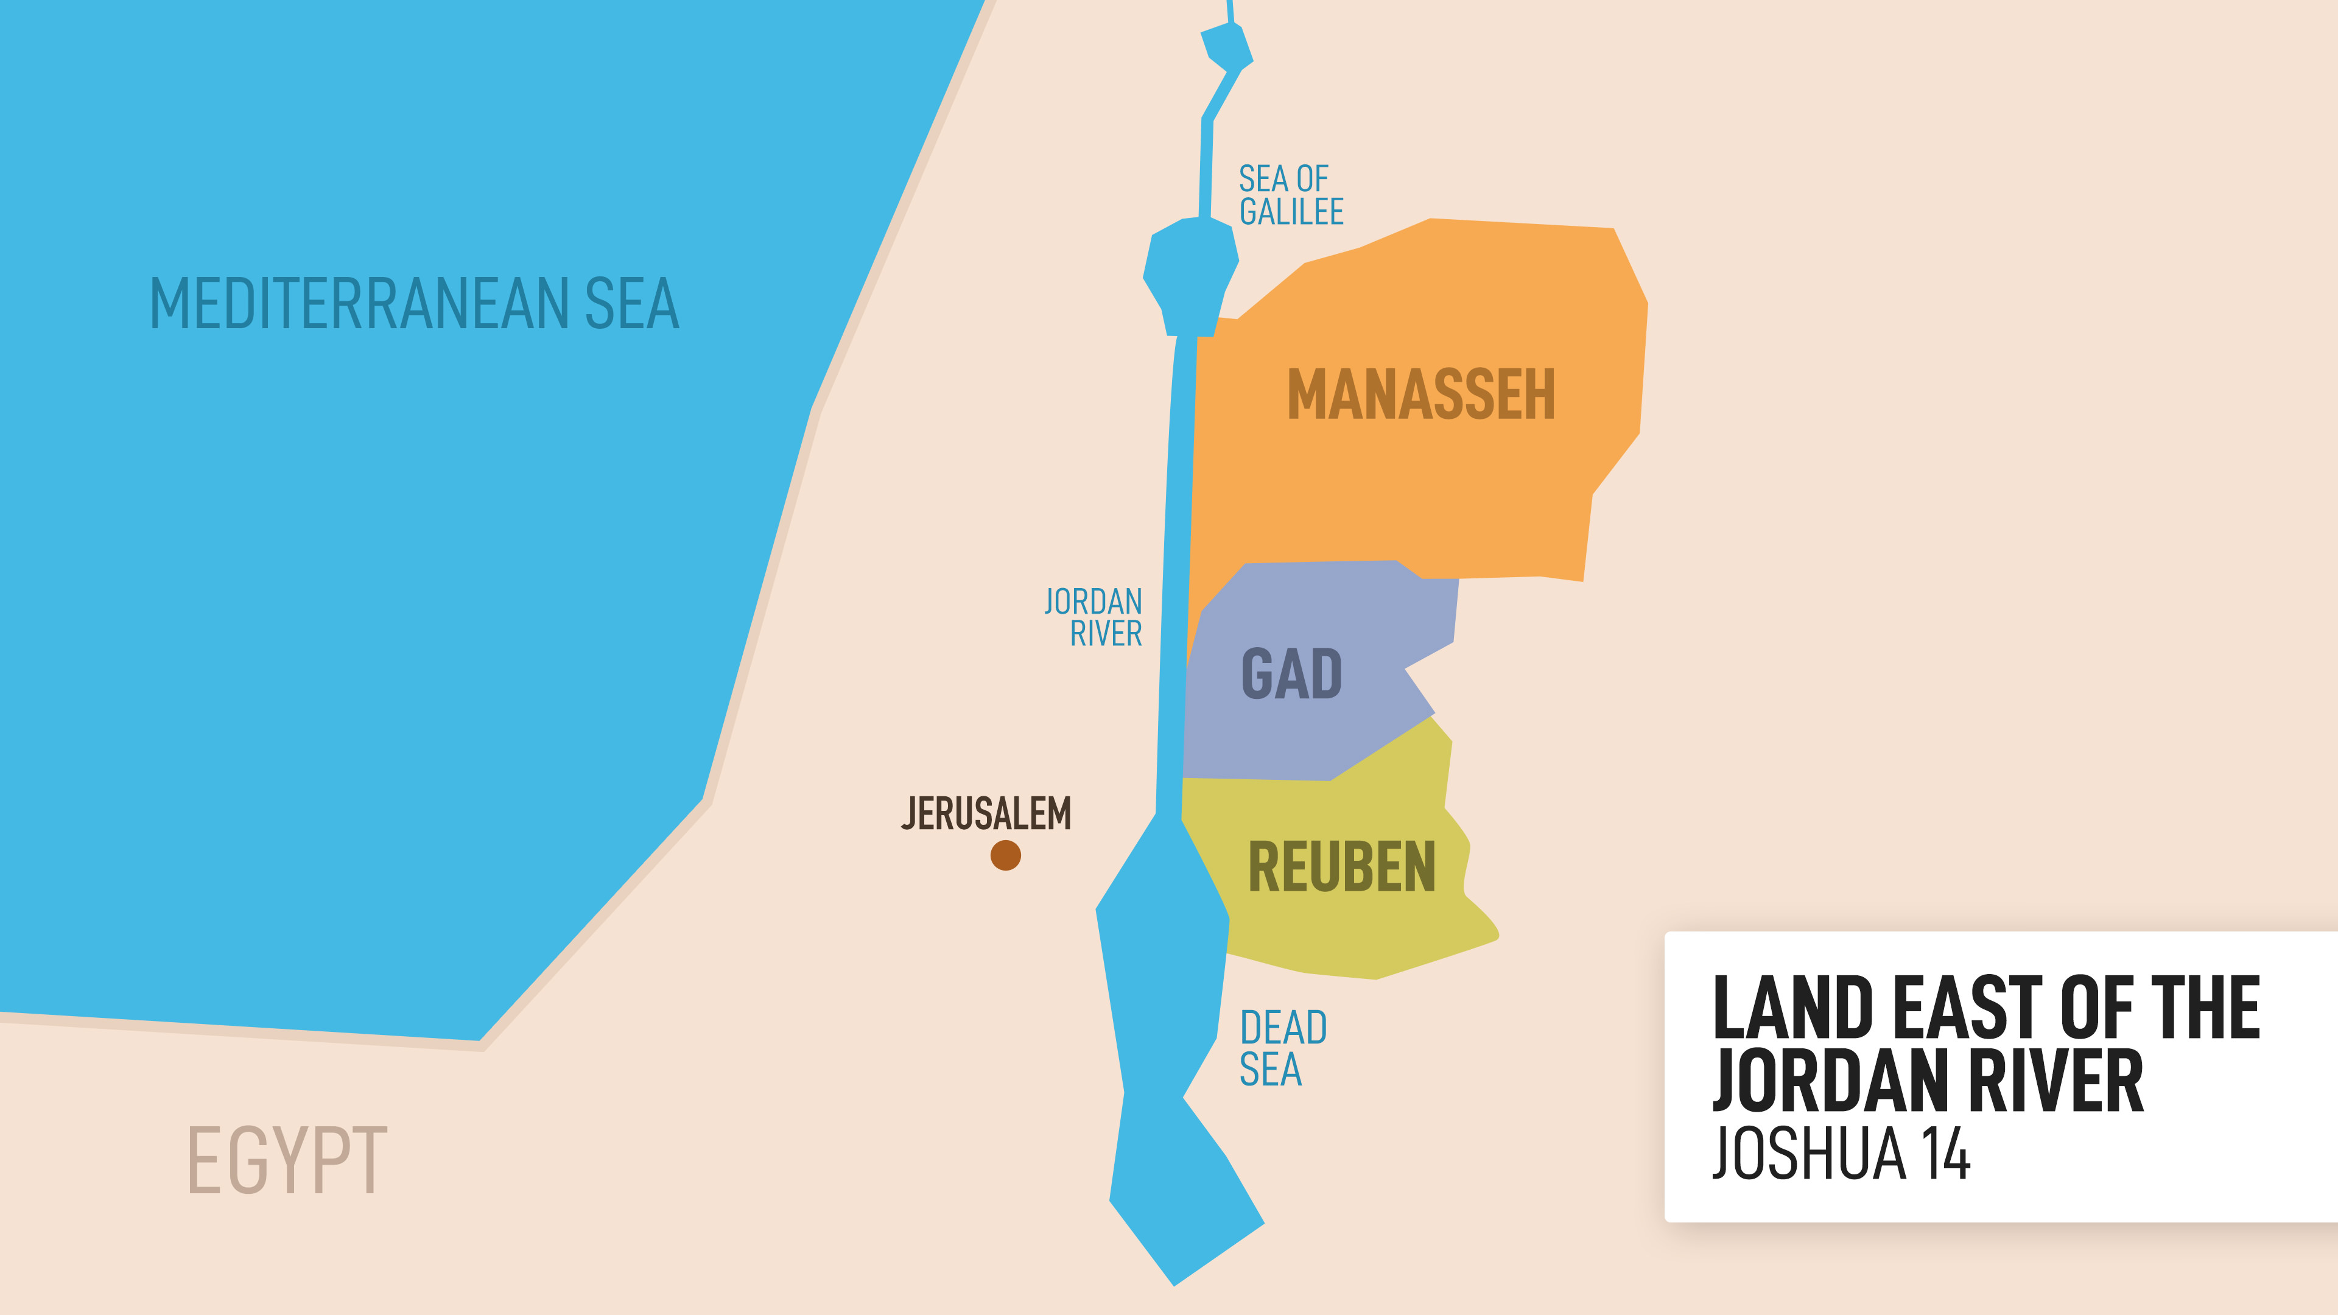

Slide 14
Deuteronomy 12:13-14
¹³ Be careful not to sacrifice your burnt offerings anywhere you please. ¹⁴ Offer them only at the place the Lord will choose in one of your tribes, and there observe everything I command you.

Slide 15
Leviticus 17:8-9
⁸ “Say to them: ‘Any Israelite or any foreigner residing among them who offers a burnt offering or sacrifice
⁹ and does not bring it to the entrance to the tent of meeting to sacrifice it to the Lord must be cut off from the people of Israel.

Slide 16
(1) Assumptions Are Dangerous
When the Israelites heard that the tribes of Reuben, Gad, and the half-tribe of Manasseh had built an altar on their own, they immediately assumed that they had rebelled against God without first finding out the facts.

Slide 17
James 1:19
¹⁹ My dear brothers and sisters, take note of this: Everyone should be quick to listen, slow to speak and slow to become angry,..

Slide 18
An Illustration On Assumptions
A teacher had two students standing across from each other while he held up a ball between them.
When he asked the two students, “What colour is this ball?” The first student looked at the ball and confidently said, “It is white.” The second student also looked and said, “It is black.”

Slide 19
An Illustration On Assumptions
Both students were surprised that they gave different answers. They began to argue, each insisting that they were correct. One said, “I can clearly see it is white,” while the other said, “No, it is clearly black.”
Then the teacher calmly explained that both students were partly right. The fact is that the ball was painted white on one side and black on the other side. Each student was only seeing one side of the ball, so each one formed a conclusion based on limited information.

Slide 20
An Illustration On Assumptions
The teacher was teaching an important lesson about assumptions. When we only see part of a situation, we can easily misunderstand and wrongly judge others. What seems clear to us may not be the whole truth.

Slide 21
For Reflection:
In situations of misunderstanding, am I quick to assume and judge, or am I willing to pause, listen carefully, and seek the full picture before responding?

Slide 22
(2) Confrontation Is Difficult But Necessary
Although confrontation is difficult and sometimes painful, it is necessary because it can prevent tensions and misunderstandings from escalating into full conflict, as we see in Joshua 22:21-29.

Slide 23
Psalm 133:1
¹ How good and pleasant it is when God’s people live together in unity!

Slide 24
For Reflection:
When facing tension or misunderstanding, do I choose to ignore it, or do I confront it in order to pursue peace and unity?

Slide 25
Conclusion:
Truth is that when there are tensions and misunderstandings, we often react with anger or become quick to judge one another instead of seeking reconciliation.
And unresolved tensions and misunderstandings can rob us of our peace and joy in worshiping God, and cause bitterness and resentment to take root in our hearts.

Slide 26
Conclusion:
For personal application, Joshua 22 challenges us to identify any unresolved tension and misunderstanding in our relationships that we need to address instead of ignoring it or assuming what is not true.

Slide 27
Conclusion:
Joshua 22 also challenges us that even in the midst of tensions and misunderstandings, we are to maintain unity in the body of Christ, the church.
This is because unity does not mean that there will never be disagreements or difficult moments among God’s people.

Slide 28
Conclusion:
For the sake of unity, we must be willing to set aside pride, avoid jumping to conclusions and deal with conflicts in a godly way—in truth and a spirit of reconciliation.

Slide 29
2 Corinthians 5:18-20
¹⁸ All this is from God, who reconciled us to himself through Christ and gave us the ministry of reconciliation: ¹⁹ that God was reconciling the world to himself in Christ, not counting people’s sins against them. And he has committed to us the message of reconciliation. ²⁰ We are therefore Christ’s ambassadors, as though God were making his appeal through us. We implore you on Christ’s behalf: Be reconciled to God.

