Slide 1
God’s Mercy and Justice
Joshua 20:1-9

Slide 2
Joshua 20:1-9
¹ Then the Lord said to Joshua: ² “Tell the Israelites to designate the cities of refuge, as I instructed you through Moses, ³ so that anyone who kills a person accidentally and unintentionally may flee there and find protection from the avenger of blood. ⁴ When they flee to one of these cities, they are to stand in the entrance of the city gate and state their case before the elders of that city. Then the elders are to admit the fugitive into their city and provide a place to live among them.

Slide 3
Joshua 20:1-9
⁵ If the avenger of blood comes in pursuit, the elders must not surrender the fugitive, because the fugitive killed their neighbor unintentionally and without malice aforethought.
⁶ They are to stay in that city until they have stood trial before the assembly and until the death of the high priest who is serving at that time. Then they may go back to their own home in the town from which they fled.”

Slide 4
Joshua 20:1-9
⁷ So they set apart Kedesh in Galilee in the hill country of Naphtali, Shechem in the hill country of Ephraim, and Kiriath Arba (that is, Hebron) in the hill country of Judah. ⁸ East of the Jordan (on the other side from Jericho) they designated Bezer in the wilderness on the plateau in the tribe of Reuben, Ramoth in Gilead in the tribe of Gad, and Golan in Bashan in the tribe of Manasseh.

Slide 5
Joshua 20:1-9
⁹ Any of the Israelites or any foreigner residing among them who killed someone accidentally could flee to these designated cities and not be killed by the avenger of blood prior to standing trial before the assembly.
This is the Word of the Lord.
Thanks be to God.

Slide 6
Genesis 15:16
¹⁶ In the fourth generation your descendants will come back here, for the sin of the Amorites has not yet reached its full measure.”

Slide 7
Wiersbe Bible Commentary OT (P.400)
“The people in the land had been given plenty of opportunity to repent and turn to the Lord... God patiently endured the evil of the Canaanites from the time of Abraham to the time of Moses, a period of over 400 years.”

Slide 8
Deuteronomy 18:9-12
⁹ When you enter the land the Lord your God is giving you, do not learn to imitate the detestable ways of the nations there. ¹⁰ Let no one be found among you who sacrifices their son or daughter in the fire, who practices divination or sorcery, interprets omens, engages in witchcraft, ¹¹ or casts spells, or who is a medium or spiritist or who consults the dead. ¹² Anyone who does these things is detestable to the Lord; because of these same detestable practices the Lord your God will drive out those nations before you.

Slide 9
Deuteronomy 20:16-18
¹⁶ “You are not to leave even one person alive in the cities of these nations that the Lord your God is about to give you as an inheritance. ¹⁷ You must completely destroy the Hittites, the Amorites, the Canaanites, the Perizzites, the Hivites, and the Jebusites, just as the Lord your God commanded you, ¹⁸ so they won’t teach you to do all the detestable things that they do for their gods. If you do what they teach you, you will sin against the Lord your God.”

Slide 10
New Bible Commentary (P.236)
“The Canaanites were exterminated because the righteous judgment of the Lord was at hand, not because of Israel's thirst for blood.”

Slide 11
Genesis 6:5
⁵ The Lord saw how great the wickedness of the human race had become on the earth, and that every inclination of the thoughts of the human heart was only evil all the time.

Slide 12
Genesis 18:20-21
²⁰ Then the Lord said, “The outcry against Sodom and Gomorrah is so great and their sin so grievous ²¹ that I will go down and see if what they have done is as bad as the outcry that has reached me. If not, I will know.”

Slide 13
Wiersbe Bible Commentary OT (P.77)
“The cities of Sodom and Gomorrah were exceedingly wicked because the men of these cities were given over to sexual practices that were contrary to nature… The men did not try to hide their sin, nor would they repent.”

Slide 14
Joshua 20:1-4
¹ Then the Lord said to Joshua: ² “Tell the Israelites to designate the cities of refuge, as I instructed you through Moses, ³ so that anyone who kills a person accidentally and unintentionally may flee there and find protection from the avenger of blood. ⁴ When they flee to one of these cities, they are to stand in the entrance of the city gate and state their case before the elders of that city. Then the elders are to admit the fugitive into their city and provide a place to live among them.

Slide 15
Wiersbe Bible Commentary OT (P.415)
“Anybody who killed another person could flee to a city of refuge and be protected from “the avenger of blood” until the elders of the city could investigate the circumstances. If they found the fugitive guilty, he or she was put to death, but if they concluded that it was a case of manslaughter, the fugitive was allowed to live in the city and be protected from the avenger.”

Slide 16
Joshua 20:5-6
⁵ If the avenger of blood comes in pursuit, the elders must not surrender the fugitive, because the fugitive killed their neighbor unintentionally and without malice aforethought.
⁶ They are to stay in that city until they have stood trial before the assembly and until the death of the high priest who is serving at that time. Then they may go back to their own home in the town from which they fled.”

Slide 17
Here are some examples of unfortunate or tragic situations in life:
a. A driver accidentally caused a road accident that injured or killed someone due to tiredness or misjudgement.
b. A worker unintentionally caused an accident due to equipment failure or misunderstanding of instructions.

Slide 18
Here are some examples of unfortunate or tragic situations in life:
c. A person accidentally and unintentionally caused injury or death when trying to stop a fight or protect someone.
d. (Which I think is the most common of all.) A person unintentionally caused harm or danger due to assumptions or ignorance.

Slide 19
For Personal Reflection:
When have you been quick to judge someone without fully understanding their situation, and how can you show more mercy and compassion like God does in the cities of refuge?

Slide 20
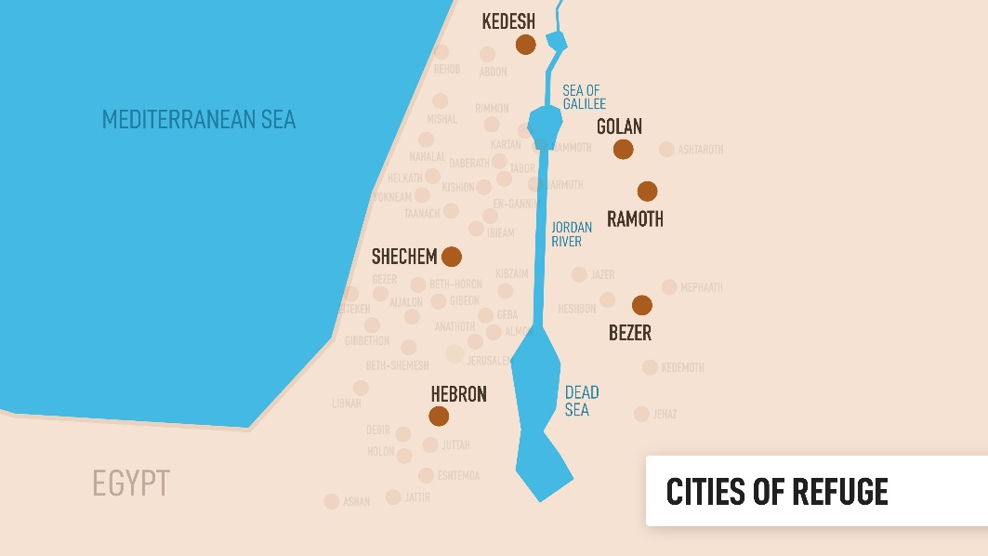
Joshua 20:7-9

Slide 21
Joshua 20:9
⁹ Any of the Israelites or any foreigner residing among them who killed someone accidentally could flee to these designated cities and not be killed by the avenger of blood prior to standing trial before the assembly.

Slide 22
What can we learn from Joshua 20:7-9 today?
(1) The church is to be a visible and accessible place of refuge for people who are wounded, burdened, and in need of God’s grace.
(2) We as the church (the Body of Christ) are to be living “cities of refuge” wherever God has placed us (e.g. in our homes, workplaces, neighbourhoods, and communities).

Slide 23
What can we learn from Joshua 20:7-9 today?
(3) Just as all the cities of refuge were extended to everyone, including foreigners residing among the Israelites, the church is not an exclusive place for a certain group of people only, but is open to all people regardless of background or status.

Slide 24
For Personal Reflection:
In what ways can I personally become a “place of refuge” for someone who is hurting or in need this week?

Slide 25
God’s Mercy and Justice
Joshua 20:1-9

