Slide 1

Content
The difference between world peace and biblical peace.
What robs us of our peace?
How to appropriate the peace of God?
How to become an instrument of God’s peace in our families?
God’s Peace in the Family

Slide 2
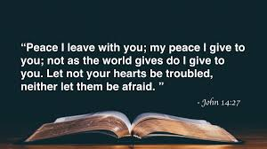
Difference between World Peace & Biblical Peace

Slide 3
Difference between World Peace & Biblical Peace
God’s peace is relational

Slide 4
Difference between World Peace & Biblical Peace
God’s peace is relational
World’s peace is circumstantial

Slide 5
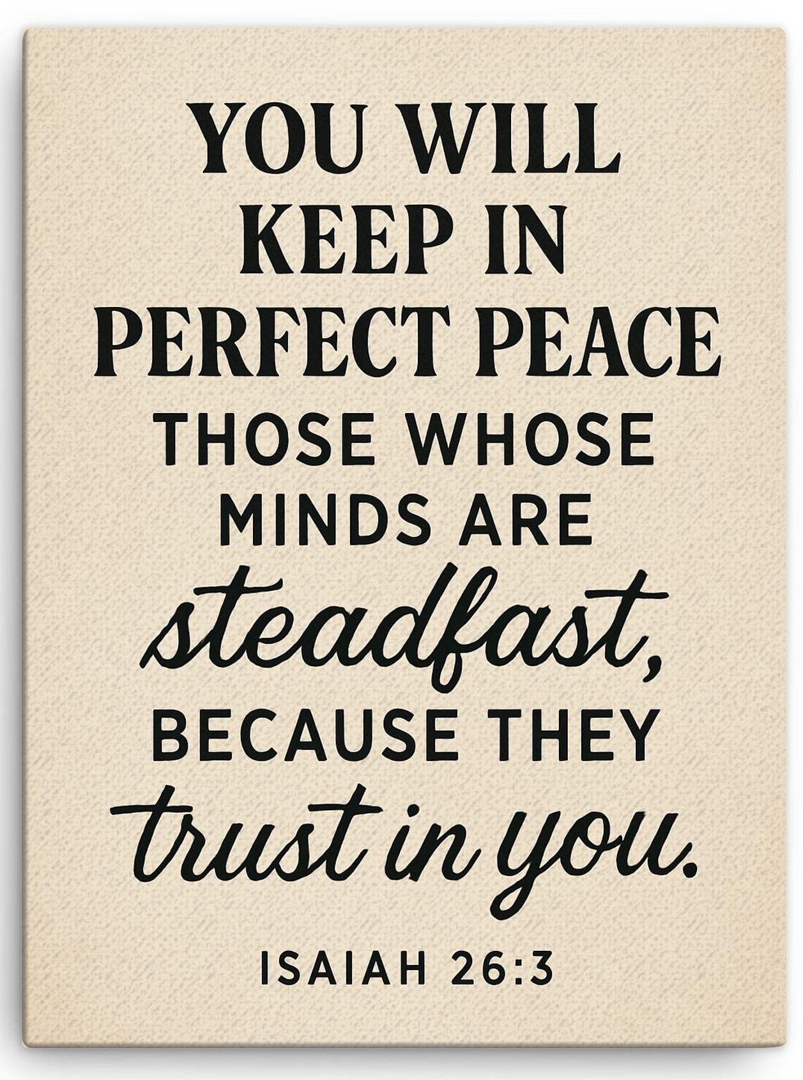
God’s Peace
Biblical peace is rooted in trust in God. When we keep our minds fixed on Him, He promises perfect, lasting peace, inner tranquillity that do not depend on external circumstances.

Slide 6
What robs us of our peace?
Pride
Unforgiveness
Anxiety and fears

Slide 7
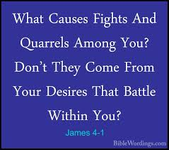
Pride
Pride refuses to listen, acts defensively and insists on its own way.
Allow humility to invite peace into your homes.

Slide 8
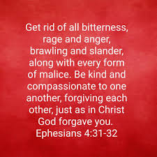
Unforgiveness
A peaceful home cannot co-exist with resentment.

Slide 9
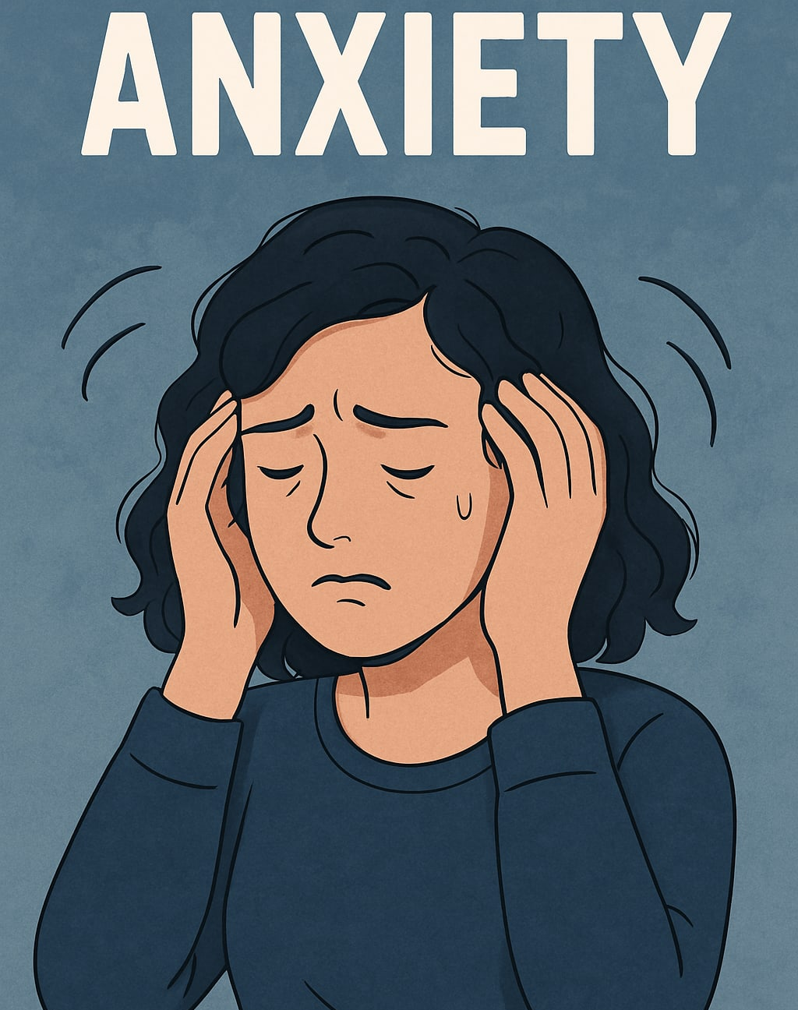
Anxiety & Fears
Fear about loss of finances, job/security.
Fear about children’s future.
Fear about illness and loss of health.
Fear about aging, dying and death.
Fear of rejection, disappointing others.
Fear of failure, disapproval and being judged.
Fear of change and unknown future.
Fear about loss of love/loss of loved ones

Slide 10
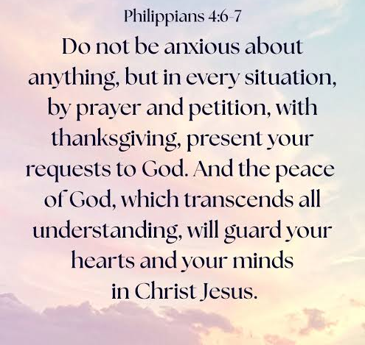
How to appropriate the peace of God?
Refuse to nurture anxiety
Pray Specifically
Add Thanksgiving
Guard the mind

Slide 11

1. Refuse to nurture anxiety
Jesus says: “Take my yoke upon you and learn from me, for I am gentle and humble in heart, and you will find rest for your souls.” Matthew 11:29
“Cast all your anxiety on Him because He cares for you.”
1 Peter 5:7

Slide 12


2. Pray specifically
“I prayed to the Lord, and he answered me. He freed me from all my fears. Those who look to him for help will be radiant with joy” - Psalm 34:4-5
“The effectiveness comes from a life which is one continual search after God, a constant seeking, a daily asking, a habitual knocking. When we pray we can in all confidence, leave the when and where to Him. For one thing is sure: He will answer”
– Dr John Edmund Haggai

Slide 13

3. Add Thanksgiving
“I will bless the Lord at all times; his praise shall continually be in my mouth”
– Psalm 34:1
“Rejoice always, pray continually, give thanks in all circumstances; for this is God’s will for you in Christ Jesus.”
- 1 Thessalonians 5: 16-18

Slide 14



4. Guard your mind
⁸ Finally, brothers and sisters, whatever is true, whatever is noble, whatever is right, whatever is pure, whatever is lovely, whatever is admirable—if anything is excellent or praiseworthy—think about such things.
Philippians 4:8

Slide 15
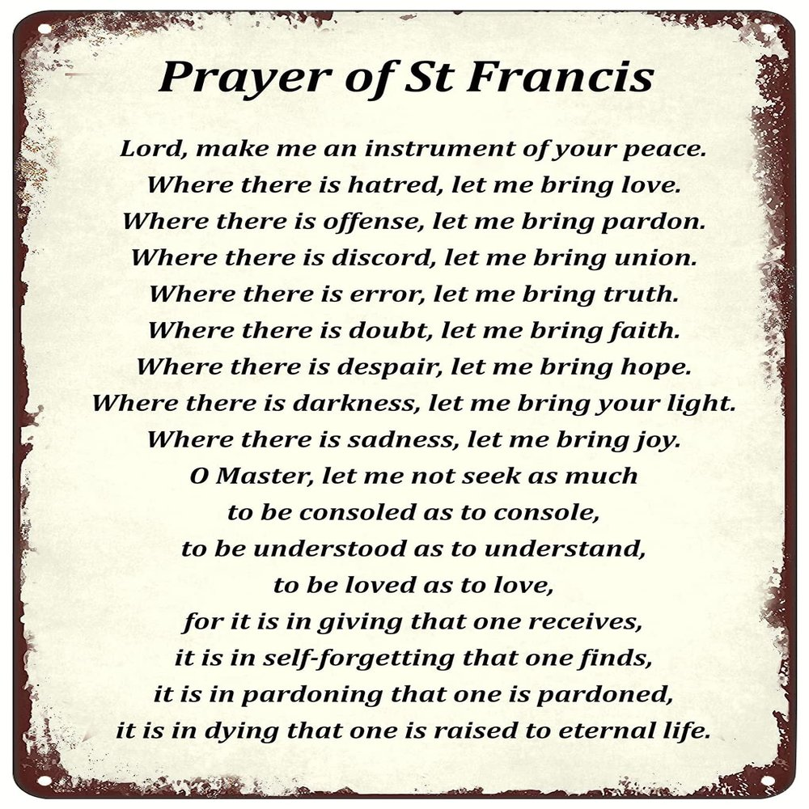
Becoming God’s instrument of peace
“Blessed are the peacemakers, for they shall be called sons of God.”
Matthew 5:9

Slide 16
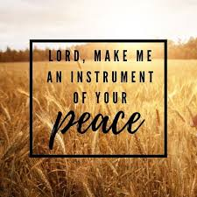
Practical Steps

Slide 17
Practical Steps
Begin with Self

Slide 18
Practical Steps
Begin with Self
Watch your Words

Slide 19
Practical Steps
Begin with Self
Watch your Words
Daily Devotions and Prayer

Slide 20
Practical Steps
Begin with Self
Watch your Words
Daily Devotions and Prayer
Practise Gratitude

Slide 21
Practical Steps
Begin with Self
Watch your Words
Daily Devotions and Prayer
Practise Gratitude
Serve one another

Slide 22
Practical Steps
Begin with Self
Watch your Words
Daily Devotions and Prayer
Practise Gratitude
Serve one another
Forgive

Slide 23
Practical Steps
Begin with Self
Watch your Words
Daily Devotions and Prayer
Practise Gratitude
Serve one another
Forgive
Resolve conflict

Slide 24
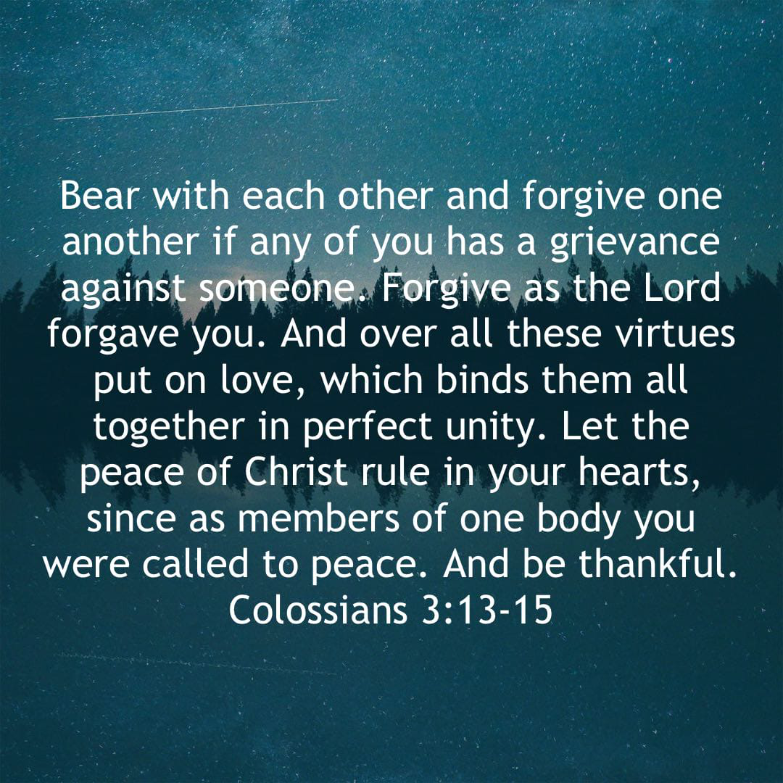
May your home be guarded by the peace of God.
May Christ’s peace rule in every heart, every conversation, every disagreement, every decision.

