Slide 1
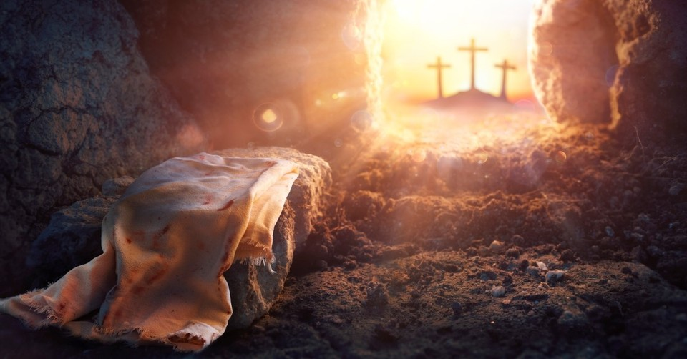
Romans 6:1-14
“The Problem of Sin and its Solution”

Slide 2
What is Sin?
Sin:
  Violating God’s law, rebelling against His will, or "missing the mark" of His holy standard.
  Wrong actions, thoughts, and attitudes.
  Disruptive force to the peace we desire for, as it separates us from God.

Slide 3
Romans 6:3-14
³ Do you not know that all of us who have been baptized into Christ Jesus were baptized into his death? ⁴ We were buried therefore with him by baptism into death, in order that, just as Christ was raised from the dead by the glory of the Father, we too might walk in newness of life.

Slide 4
⁵ For if we have been united with him in a death like his, we shall certainly be united with him in a resurrection like his. ⁶ We know that our old self was crucified with him in order that the body of sin might be brought to nothing, so that we would no longer be enslaved to sin.

Slide 5
⁸ Now if we have died with Christ, we believe that we will also live with him. ⁹ We know that Christ, being raised from the dead, will never die again; death no longer has dominion over him.

Slide 6
¹⁰ For the death he died he died to sin, once for all, but the life he lives he lives to God. ¹¹ So you also must consider yourselves dead to sin and alive to God in Christ Jesus. ¹² Let not sin therefore reign in your mortal body, to make you obey its passions.

Slide 7
¹³ Do not present your members to sin as instruments for unrighteousness, but present yourselves to God as those who have been brought from death to life, and your members to God as instruments for righteousness. ¹⁴ For sin will have no dominion over you, since you are not under law but under grace.

Slide 8
Context
In Romans 6, Paul was talking about three major things:
  Death to sin
  God’s offer of salvation
  Living the new life

Slide 9
In verse 3, Paul was saying that all who choose to believe in Jesus have been “baptized” into Christ Jesus. And all who have been baptized into Christ Jesus have also been baptized into His death.

Slide 10
Giving our life in Jesus means to believe that:
  Jesus came into our world to solve the problem of sin and evil
  Jesus died on the Cross to pay for our sins
  Jesus was resurrected on the 3rd day, to grant to us the new life that conquered sin.

Slide 11
The moment we give our life to Jesus, four things happened (all at the same time)
  We died
  We are freed from sin
  We are raised
  We walk in the newness of life

Slide 12
We died!
Paul was not referring to our physical death. Paul was talking about death to our old self.

Slide 13
We died!
Romans 1:16 (ESV): "For I am not ashamed of the gospel, for it is the power of God for salvation to everyone who believes, to the Jew first and also to the Greek".

Slide 14
Freed from sin!
Verse 6 “We know that our old self was crucified with him in order that the body of sin might be brought to nothing, so that we would no longer be enslaved to sin.”

Slide 15
Newness of life!
It is not just a second chance. It is not just an “improvement” so we can do better. It is a turn around for all who believes. All sins are washed away. A completely brand-new life awaits!

Slide 16
Sin no more…
Verses 11-14: “So you also must consider yourselves dead to sin and alive to God in Christ Jesus. ¹² Let not sin therefore reign in your mortal body, to make you obey its passions.”

Slide 17
Sin no more…
¹³ Do not present your members to sin as instruments for unrighteousness, but present yourselves to God as those who have been brought from death to life, and your members to God as instruments for righteousness. ¹⁴ For sin will have no dominion over you, since you are not under law but under grace.

Slide 18
“You don’t have to know a lot of things for your life to make a lasting difference in the world. But you do have to know the few great things that matter, perhaps just one, and then be willing to live for them and die for them.
The people that make a durable difference in the world are not the people who have mastered many things, but who have been mastered by one great thing.”
John Piper, Don't Waste Your Life

Slide 19
Discussion questions
What was Paul referring to when he said that those who believe in Jesus is also baptized into His death?
Why do you think we need to “die” in order to be freed from the power of sin?
To what extent are you living as someone who is freed from the power of sin? Explain your answer.
How do you consider the reality that believers can live the newness of life and even the eternity to come? How would you explain this grace of God to those who do not know Him?

