Slide 1
Restored and Advancing
Joshua 8:1-35

Slide 2
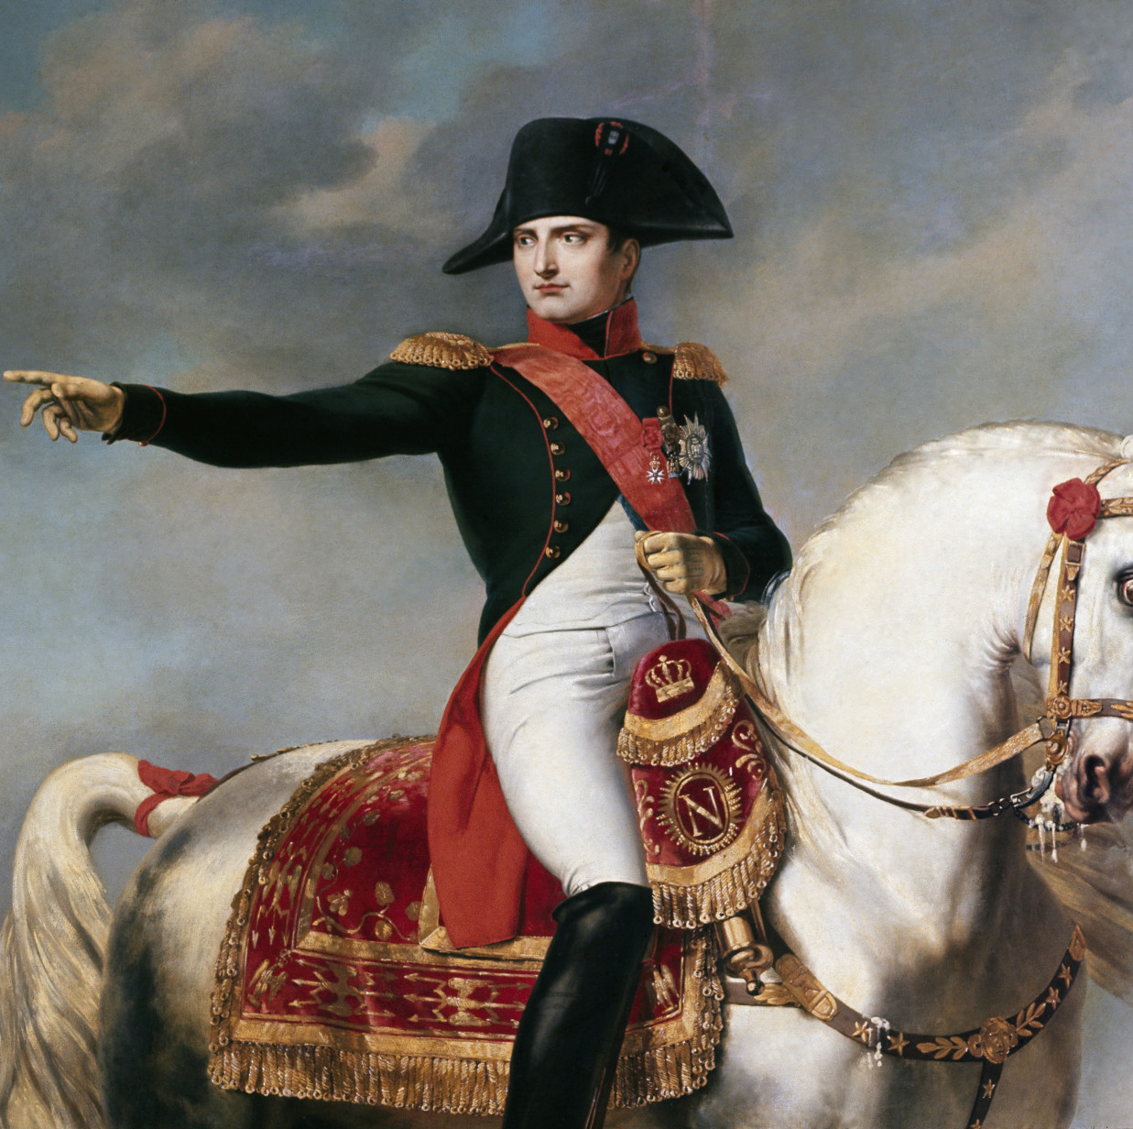
In 1812, Napoleon Bonaparte, one of the greatest military leaders in history, led a massive army of over 600,000 soldiers to invade Russia.

Slide 3
Napoleon’s defeat was not because his army was incapable of fighting or lacked military power; it was because he assumed that past success guaranteed future victory.

Slide 4
The Israelites Assumed That Conquering Ai Would Be Just As Easy.
Joshua 7:3
“Not all the army will have to go up against Ai. Send two or three thousand men to take it and do not weary the whole army, for only a few people live there.”

Slide 5
The Israelites Assumed That Conquering Ai Would Be Just As Easy.
Past success does not secure future victory if we are unfaithful or disobedient to God.
God does not automatically grant us success; it comes when we stay faithful and obedient to Him.

Slide 6
The Israelites Assumed That Conquering Ai Would Be Just As Easy.
The problem is that many of us are stuck in memories of the past when we were once ‘on fire’ for God, but our current spiritual life no longer has that same passion.

Slide 7
For Personal Reflection:
Am I relying only on my past memories of experiences with God, or am I still actively growing in faith and obedience today?

Slide 8
Joshua 8:1-9
¹ Then the Lord said to Joshua, “Do not be afraid; do not be discouraged. Take the whole army with you, and go up and attack Ai. For I have delivered into your hands the king of Ai, his people, his city and his land. ² You shall do to Ai and its king as you did to Jericho and its king, except that you may carry off their plunder and livestock for yourselves. Set an ambush behind the city.”

Slide 9
Joshua 8:1-9
³ So Joshua and the whole army moved out to attack Ai. He chose thirty thousand of his best fighting men and sent them out at night ⁴ with these orders: “Listen carefully. You are to set an ambush behind the city. Don’t go very far from it. All of you be on the alert. ⁵ I and all those with me will advance on the city, and when the men come out against us, as they did before, we will flee from them.

Slide 10
Joshua 8:1-9
⁶ They will pursue us until we have lured them away from the city, for they will say, ‘They are running away from us as they did before.’ So when we flee from them, ⁷ you are to rise up from ambush and take the city. The Lord your God will give it into your hand. ⁸ When you have taken the city, set it on fire. Do what the Lord has commanded. See to it; you have my orders.”

Slide 11
Joshua 8:1-9
⁹ Then Joshua sent them off, and they went to the place of ambush and lay in wait between Bethel and Ai, to the west of Ai—but Joshua spent that night with the people.

Slide 12
(1) God Reaffirm His Promise Of Victory To The Israelites.
Once Achan’s hidden sin had been dealt with (see Joshua 7:24-26), God reassured Joshua by reaffirming His promise of victory in Joshua 8:1.
God did not want His people to dwell on their failure or defeat. Instead, He wanted to restore them and lead them to victory once again.

Slide 13
Wiersbe Bible Commentary
“When you surrender to the Lord, no defeat is permanent and no mistake is beyond remedy. Even the “Valley of Trouble” can become a “door of hope”.”

Slide 14
Jeremiah 3:22
“Return, faithless people; I will cure you of backsliding.”

Slide 15
For Personal Reflection:
Have I been holding on to past failure or defeat, allowing them to keep me from moving forward with God?

Slide 16
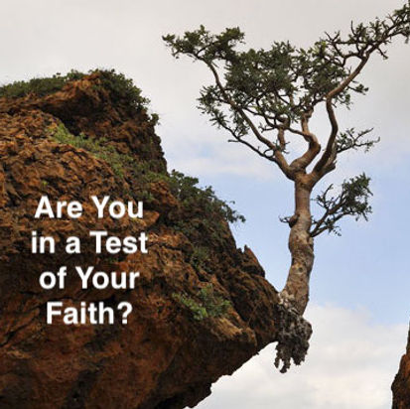
(2) God Again Tested The Faith And Obedience Of The Israelites.

Slide 17
Joshua 8:10-29
¹⁰ Early the next morning Joshua mustered his army, and he and the leaders of Israel marched before them to Ai. ¹¹ The entire force that was with him marched up and approached the city and arrived in front of it. They set up camp north of Ai, with the valley between them and the city. ¹² Joshua had taken about five thousand men and set them in ambush between Bethel and Ai, to the west of the city.

Slide 18
Joshua 8:10-29
¹³ So the soldiers took up their positions—with the main camp to the north of the city and the ambush to the west of it. That night Joshua went into the valley. ¹⁴ When the king of Ai saw this, he and all the men of the city hurried out early in the morning to meet Israel in battle at a certain place overlooking the Arabah. But he did not know that an ambush had been set against him behind the city. ¹⁵ Joshua and all Israel let themselves be driven back before them, and they fled toward the wilderness.

Slide 19
Joshua 8:10-29
¹⁶ All the men of Ai were called to pursue them, and they pursued Joshua and were lured away from the city. ¹⁷ Not a man remained in Ai or Bethel who did not go after Israel. They left the city open and went in pursuit of Israel. ¹⁸ Then the Lord said to Joshua, “Hold out toward Ai the javelin that is in your hand, for into your hand I will deliver the city.” So Joshua held out toward the city the javelin that was in his hand.

Slide 20
Joshua 8:10-29
¹⁹ As soon as he did this, the men in the ambush rose quickly from their position and rushed forward. They entered the city and captured it and quickly set it on fire. ²⁰ The men of Ai looked back and saw the smoke of the city rising up into the sky, but they had no chance to escape in any direction; the Israelites who had been fleeing toward the wilderness had turned back against their pursuers.

Slide 21
Joshua 8:10-29
²¹ For when Joshua and all Israel saw that the ambush had taken the city and that smoke was going up from it, they turned around and attacked the men of Ai. ²² Those in the ambush also came out of the city against them, so that they were caught in the middle, with Israelites on both sides. Israel cut them down, leaving them neither survivors nor fugitives. ²³ But they took the king of Ai alive and brought him to Joshua.

Slide 22
Joshua 8:10-29
²⁴ When Israel had finished killing all the men of Ai in the fields and in the wilderness where they had chased them, and when every one of them had been put to the sword, all the Israelites returned to Ai and killed those who were in it. ²⁵ Twelve thousand men and women fell that day—all the people of Ai. ²⁶ For Joshua did not draw back the hand that held out his javelin until he had destroyed all who lived in Ai.

Slide 23
Joshua 8:10-29
²⁷ But Israel did carry off for themselves the livestock and plunder of this city, as the Lord had instructed Joshua. ²⁸ So Joshua burned Ai and made it a permanent heap of ruins, a desolate place to this day. ²⁹ He impaled the body of the king of Ai on a pole and left it there until evening. At sunset, Joshua ordered them to take the body from the pole and throw it down at the entrance of the city gate. And they raised a large pile of rocks over it, which remains to this day.

Slide 24
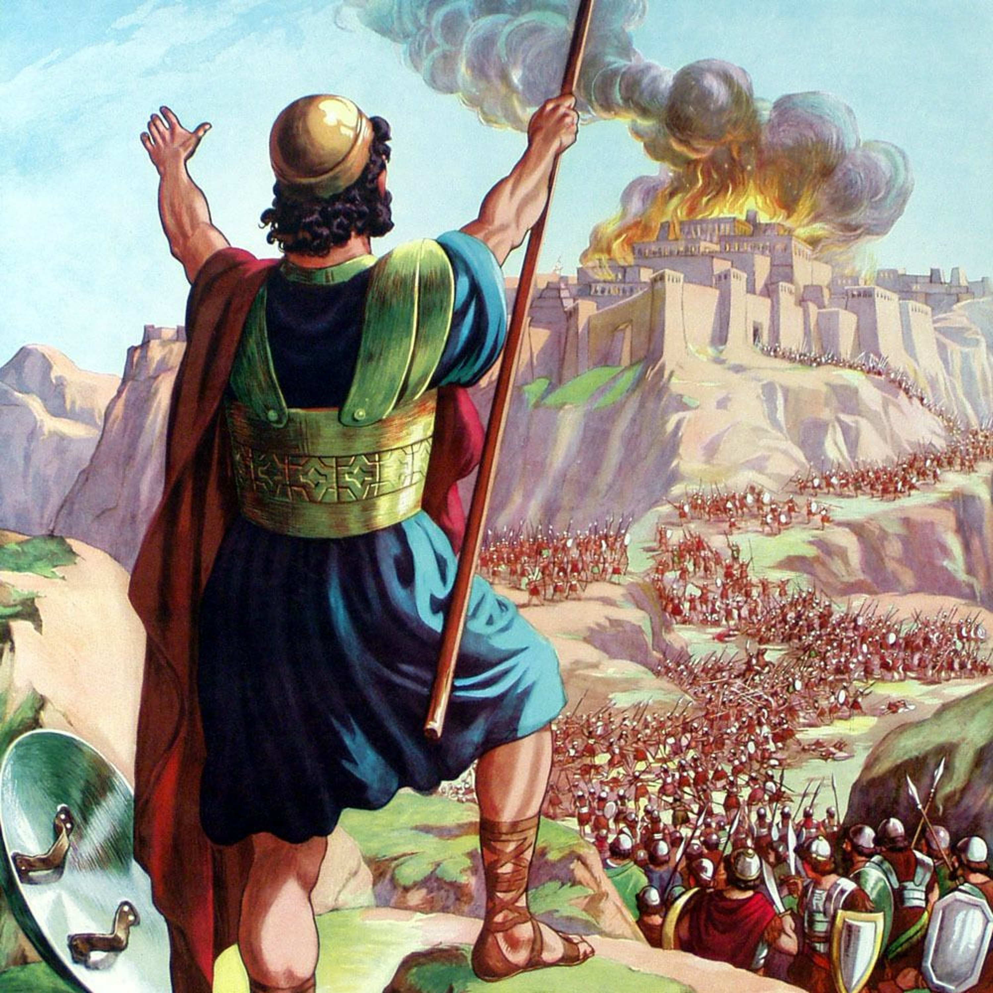
Joshua 8:10-29 records an epic battle that unfolded exactly as God instructed Joshua.

Slide 25
Joshua 8 teaches us not to always look for a miracle, but to trust God completely and follow the guidance He provides in His Word.

Slide 26
For Personal Reflection:
Am I willing to step out in faith and obedience, trusting God to work through my weaknesses to accomplish His purposes?

Slide 27
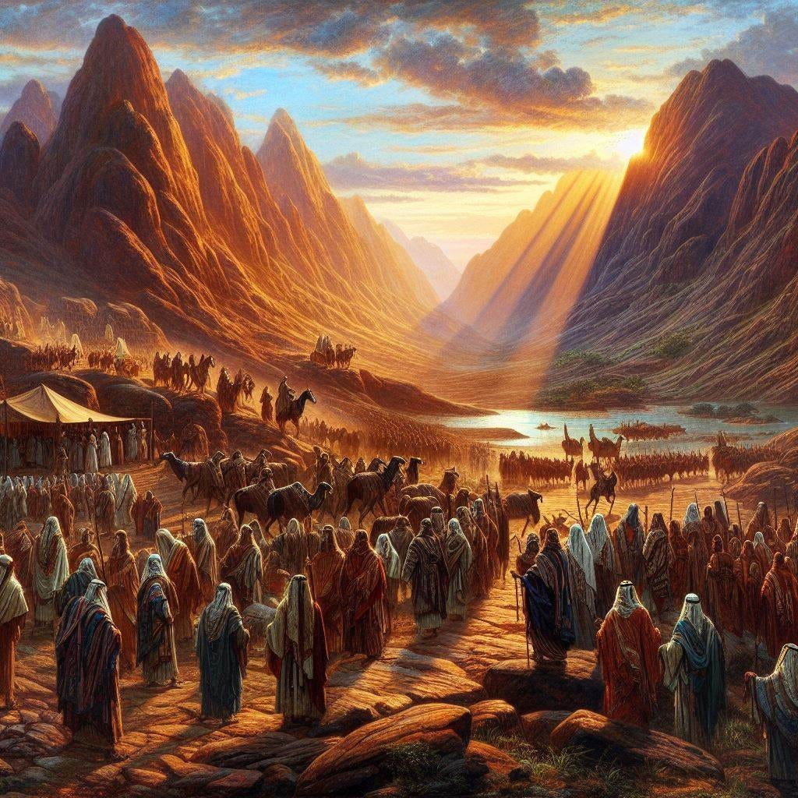
3. God Renewed The Israelites’ Commitment To Him.

Slide 28
Joshua 8:30-35
³⁰ Then Joshua built on Mount Ebal an altar to the Lord, the God of Israel, ³¹ as Moses the servant of the Lord had commanded the Israelites. He built it according to what is written in the Book of the Law of Moses—an altar of uncut stones, on which no iron tool had been used. On it they offered to the Lord burnt offerings and sacrificed fellowship offerings. ³² There, in the presence of the Israelites, Joshua wrote on stones a copy of the law of Moses.

Slide 29
Joshua 8:30-35
³³ All the Israelites, with their elders, officials and judges, were standing on both sides of the ark of the covenant of the Lord, facing the Levitical priests who carried it. Both the foreigners living among them and the native-born were there. Half of the people stood in front of Mount Gerizim and half of them in front of Mount Ebal, as Moses the servant of the Lord had formerly commanded when he gave instructions to bless the people of Israel.

Slide 30
Joshua 8:30-35
³⁴ Afterward, Joshua read all the words of the law—the blessings and the curses—just as it is written in the Book of the Law. ³⁵ There was not a word of all that Moses had commanded that Joshua did not read to the whole assembly of Israel, including the women and children, and the foreigners who lived among them.

Slide 31
After the Israelites successfully captured the city of Ai, Joshua read the blessings and curses in the Book of the Law to reaffirm their covenant with God.

Slide 32
Ultimately, Joshua 8 clearly teaches us that God’s blessing is not automatic and cannot be received simply because we “claim” it by faith; rather, it comes through faithful obedience.

Slide 33
For Personal Reflection:
What practical steps can I take today to stay faithful and obedient to God, so that I can continue experiencing His blessings?

Slide 34
In Conclusion
1. Despite our failures or backsliding, God wants to restore us and lead us to victory again.
2. Not to always look for a miracle, but to trust God completely and follow the guidance He provides in His Word.
3. God’s blessings are not automatic and come only through faithful obedience to Him.

Slide 35
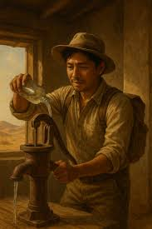
There is a story about a man who got lost in the desert and came across an old water pump...

Slide 36
Discussion Questions
Read Joshua 8:1-2. After Israel’s failure, God reassured Joshua and called them to move forward again. What does this teach us about God’s grace and restoration after we fail?
Read Jeremiah 3:22. How does this promise encourage those who feel they have drifted away from God?
Read Joshua 8:18–19. The Israelites followed God’s instructions carefully in the battle plan against Ai. What are some ways we can practice trusting and obeying God even when His instructions are not easy or obvious?
Read Joshua 8:34–35. After the victory, Joshua led the people in renewing their covenant with God by reading the Law. What practical steps can help us renew our commitment to God and remain faithful to Him daily?

