Slide 1
Joshua 11: True Rest From Obedience
29 March 2026: Last Sunday of Lent

Slide 2
What does it mean to “rest”?

Slide 3
Sleep deprived!
Singapore: among the top sleep-deprived nations, 51% having less than 7 hours of sleep daily.
9 out of 10 Singaporeans experience disrupted sleep.
61% often wake up feeling tired.

Slide 4
Top factors affecting rest
Work related stress
Digital device
Work-life issues
Poor mental health

Slide 5
Vicious cycle of “toil and leisure”:
Unsustainable rhythm where we work until exhaustion and then collapse into passive "leisure”, which fails to truly restore them, leading to a relentless, unfulfilling loop.

Slide 6
Joshua 11:1-23
When Jabin, king of Hazor, heard of this (Israel conquered southern Canaan), he sent to Jobab king of Madon, and to the king of Shimron, and to the king of Achshaph, ² and to the kings who were in the northern hill country, and in the Arabah south of Chinneroth, and in the lowland, and in Naphoth-dor on the west, ³ to the Canaanites in the east and the west, the Amorites, the Hittites, the Perizzites, and the Jebusites in the hill country, and the Hivites under Hermon in the land of Mizpah.

Slide 7
⁴ And they came out with all their troops, a great horde, in number like the sand that is on the seashore, with very many horses and chariots. ⁵ And all these kings joined their forces and came and encamped together at the waters of Merom to fight against Israel. ⁶ And the Lord said to Joshua, “Do not be afraid of them, for tomorrow at this time I will give over all of them, slain, to Israel. You shall hamstring their horses and burn their chariots with fire.” ⁷ So Joshua and all his warriors came suddenly against them by the waters of Merom and fell upon them.

Slide 8
⁸ And the Lord gave them into the hand of Israel, who struck them and chased them as far as Great Sidon and Misrephoth-maim, and eastward as far as the Valley of Mizpeh. And they struck them until he left none remaining. ⁹ And Joshua did to them just as the Lord said to him: he hamstrung their horses and burned their chariots with fire. ¹⁰ And Joshua turned back at that time and captured Hazor and struck its king with the sword, for Hazor formerly was the head of all those kingdoms.

Slide 9
¹¹ And they struck with the sword all who were in it, devoting them to destruction; there was none left that breathed. And he burned Hazor with fire. ¹² And all the cities of those kings, and all their kings, Joshua captured, and struck them with the edge of the sword, devoting them to destruction, just as Moses the servant of the Lord had commanded. ¹³ But none of the cities that stood on mounds did Israel burn, except Hazor alone; that Joshua burned.

Slide 10
¹⁴ And all the spoil of these cities and the livestock, the people of Israel took for their plunder. But every person they struck with the edge of the sword until they had destroyed them, and they did not leave any who breathed. ¹⁵ Just as the Lord had commanded Moses his servant, so Moses commanded Joshua, and so Joshua did. He left nothing undone of all that the Lord had commanded Moses.

Slide 11
¹⁶ So Joshua took all that land, the hill country and all the Negeb and all the land of Goshen and the lowland and the Arabah and the hill country of Israel and its lowland ¹⁷ from Mount Halak, which rises toward Seir, as far as Baal-gad in the Valley of Lebanon below Mount Hermon. And he captured all their kings and struck them and put them to death. ¹⁸ Joshua made war a long time with all those kings.

Slide 12
¹⁹ There was not a city that made peace with the people of Israel except the Hivites, the inhabitants of Gibeon. They took them all in battle. ²⁰ For it was the Lord's doing to harden their hearts that they should come against Israel in battle, in order that they should be devoted to destruction and should receive no mercy but be destroyed, just as the Lord commanded Moses.

Slide 13
²¹ And Joshua came at that time and cut off the Anakim from the hill country, from Hebron, from Debir, from Anab, and from all the hill country of Judah, and from all the hill country of Israel. Joshua devoted them to destruction with their cities. ²² There was none of the Anakim left in the land of the people of Israel. Only in Gaza, in Gath, and in Ashdod did some remain.

Slide 14
²³ So Joshua took the whole land, according to all that the Lord had spoken to Moses. And Joshua gave it for an inheritance to Israel according to their tribal allotments. And the land had rest from war.
Word of the Lord!

Slide 15
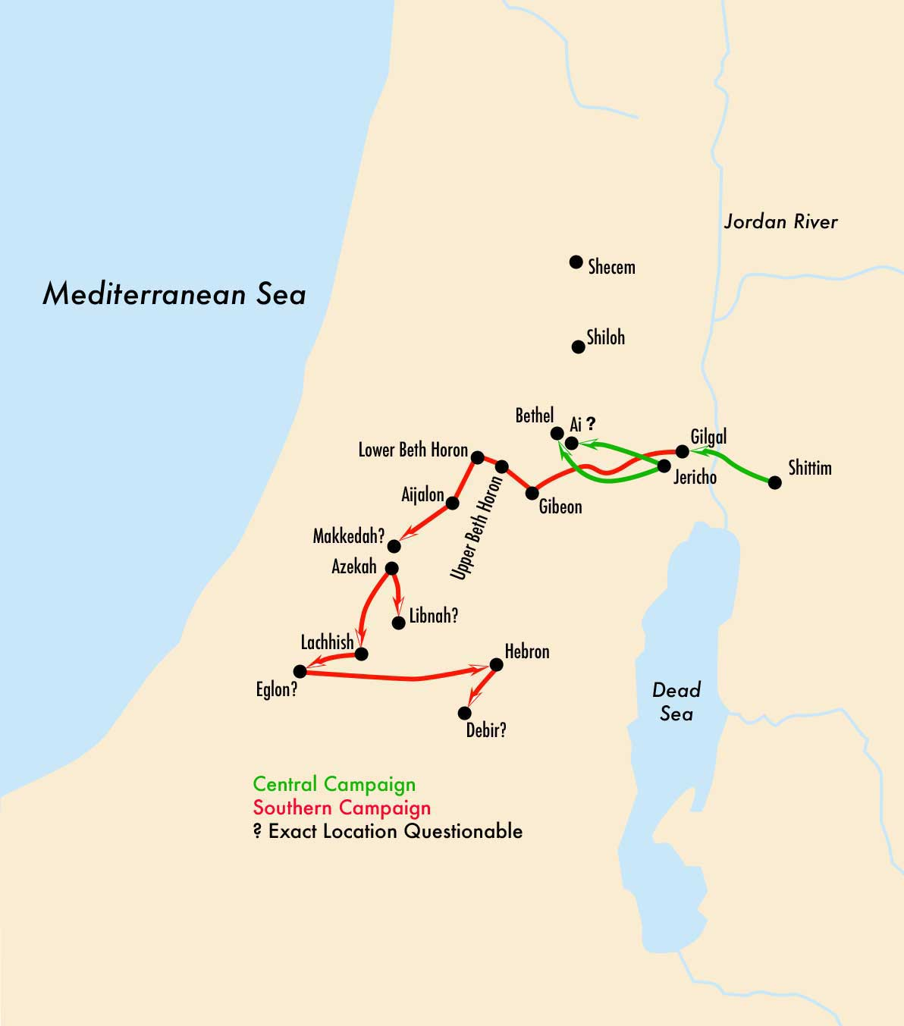
Israel’s southern campaign

Slide 16
Joshua 11:1-5
In verses 1-5, we are told that when these northern kings gathered, they were described to be like a “great horde, in number like the sand that is on the seashore, with very many horses and chariots.”

Slide 17
Reflection
Evil did not retreat. Instead, they strive to put up a rebellious confrontation; to defend their own survival and influence.
Such behaviour from evil is consistent with the Psalms (e.g. Psalm 83) and also New Testament (e.g. Ephesians 6:12)

Slide 18
Reflection
If in the midst of our obedience to the word of God; we face difficulties, disappointments or even a personal lack of confidence…..

Slide 19
Reflection
We are not to give up because it is to be expected.
Our obedience to God can and will invite oppositions; either from our own flesh, the discouraging opinions of others or spiritual forces of darkness.

Slide 20
Reflection
The most helpful thing we can do at these moments, is to be like Joshua.
Listen, obey and do it. God will help us.

Slide 21
God is greater!
“Do not be afraid of them, for tomorrow at this time I will give over all of them, slain, to Israel. You shall hamstring their horses and burn their chariots with fire.”

Slide 22
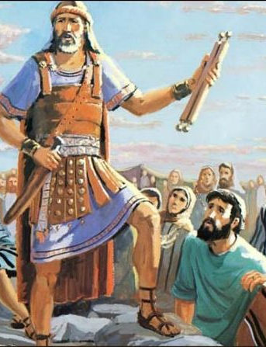
Even when the odds seem insurmountable, even when the instructions did not seem to make sense, Joshua chose to trust God in His word and obeyed.
Mentioned six times how Joshua did according to “what God commanded him to do”.

Slide 23
Reflection
We are not alone in our struggles.
We have an example in Joshua.
Joshua trusted God and because of his obedience in faith, Joshua was granted victory.

Slide 24
True rest from Obedience
Verse 23 says: ²³ So Joshua took the whole land, according to all that the Lord had spoken to Moses. And Joshua gave it for an inheritance to Israel according to their tribal allotments. And the land had rest from war.

Slide 25
“rest” in verse 23 is translated from the Hebrew root word “shaqat”.
“shaqat” literally mean the cessation of hostilities. It is also used frequently in the book of Joshua and Judges to to mean a period of tranquillity, of peace and quietness.

Slide 26
“rest” in verse 23, means that the people of Israel, because of their obedience, had finally fulfilled what God wanted them to do.
And because of that, they found peace and a period of fruitfulness and blessings with God.

Slide 27
In Matthew 11:28-30:
²⁸ Come to me, all who labor and are heavy laden, and I will give you rest. ²⁹ Take my yoke upon you, and learn from me, for I am gentle and lowly in heart, and you will find rest for your souls. ³⁰ For my yoke is easy, and my burden is light.”
Just as Joshua led Israel to find rest from war through obedience; Jesus led us to find rest in Him through His obedience on the Cross.

Slide 28
This “rest” found in our obedience of Jesus will help us to break out of the unsustainable rhythm of toil and leisure.

Slide 29
How to have “true rest”?
  Firstly, we need to understand God’s purpose of rest.
  Secondly, we need to trust God and do as He commands.

Slide 30
How to have “true rest”?
In the Bible, the purpose of rest is not a pity reward after working long and hard (for God is not a slave master); but the purpose of rest is for man to enjoy God and be refilled in the Spirit after fulfilling His word for work.

Slide 31
How to have true rest?
In our world, we often rest only when we feel exhausted. Or we rest because we are forced to (sickness or spouse)
Yet God’s purpose of rest showed us that we are not to work for our rest, but we work from our rest – Grechen Saffles

Slide 32
How to have true rest?
When we work for our rest, we rest only when our physical and mental bodies tells us to.
When we work from our rest, we learn to prioritize rest so that from there, we learn to glorify God in the work He had given.

Slide 33
“Sabbath” was not meant to be spent in mere leisure or “sleeping in”.
It was meant to be a time of “godly rest”!

Slide 34
Sabbath?
  Worship God and be in His presence.
  Trust God that He continues to work even when you are not working.
  Give thanks to God for the work done for the week.
  Fellowship with believers and family.
  Helping others when help is needed (as Jesus did).

Slide 35
Matthew 11:28-30
²⁸ Come to me, all who labor and are heavy laden, and I will give you rest. ²⁹ Take my yoke upon you, and learn from me, for I am gentle and lowly in heart, and you will find rest for your souls. ³⁰ For my yoke is easy, and my burden is light.”

Slide 36
Discussion questions
Recall a time when you are trying to obey God and things become even more difficult for you. How did you respond? In reflection, what would be a better response (if any?)
What motivates Joshua to obey God’s commands, even when the enemies were so vast and seemingly insurmountable? Can the same motivation be applied to our daily living in Christ?
What is your understanding of “rest”? Based on such an understanding, how rested are you? Do you find yourself trapped in the cycle of toil-leisure?
Based on the Bible’s perspectives for rest, how can we rest deeper and better?

