Slide 1
Renewal at Gilgal
Joshua 5:1-15

Slide 2
Joshua 5:1-15
¹ Now when all the Amorite kings west of the Jordan and all the Canaanite kings along the coast heard how the Lord had dried up the Jordan before the Israelites until they had crossed over, their hearts melted in fear and they no longer had the courage to face the Israelites.

Slide 3
Joshua 5:1-15
² At that time the Lord said to Joshua, “Make flint knives and circumcise the Israelites again.”
³ So Joshua made flint knives and circumcised the Israelites at Gibeath Haaraloth. ⁴ Now this is why he did so: All those who came out of Egypt—all the men of military age—died in the wilderness on the way after leaving Egypt.

Slide 4
Joshua 5:1-15
⁵ All the people that came out had been circumcised, but all the people born in the wilderness during the journey from Egypt had not. ⁶ The Israelites had moved about in the wilderness forty years until all the men who were of military age when they left Egypt had died, since they had not obeyed the Lord. For the Lord had sworn to them that they would not see the land he had solemnly promised their ancestors to give us, a land flowing with milk and honey.

Slide 5
Joshua 5:1-15
⁷ So he raised up their sons in their place, and these were the ones Joshua circumcised. They were still uncircumcised because they had not been circumcised on the way. ⁸ And after the whole nation had been circumcised, they remained where they were in camp until they were healed. ⁹ Then the Lord said to Joshua, “Today I have rolled away the reproach of Egypt from you.” So the place has been called Gilgal to this day. ¹⁰ On the evening of the fourteenth day of the month, while camped at Gilgal on the plains of Jericho, the Israelites celebrated the Passover.

Slide 6
Joshua 5:1-15
¹¹ The day after the Passover, that very day, they ate some of the produce of the land: unleavened bread and roasted grain. ¹² The manna stopped the day after they ate this food from the land; there was no longer any manna for the Israelites, but that year they ate the produce of Canaan. ¹³ Now when Joshua was near Jericho, he looked up and saw a man standing in front of him with a drawn sword in his hand. Joshua went up to him and asked, “Are you for us or for our enemies?”

Slide 7
Joshua 5:1-15
¹⁴ “Neither,” he replied, “but as commander of the army of the Lord I have now come.” Then Joshua fell facedown to the ground in reverence, and asked him, “What message does my Lord have for his servant?”
¹⁵ The commander of the Lord’s army replied, “Take off your sandals, for the place where you are standing is holy.” And Joshua did so.
This is the Word of the Lord. Thanks be to God.

Slide 8

Who Was The Superhero You Grew Up With?

Slide 9
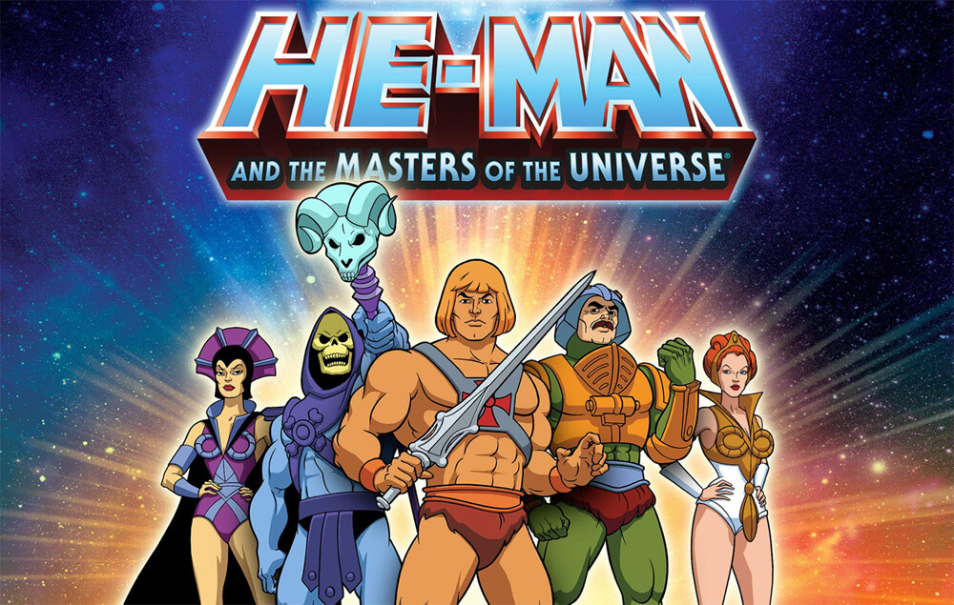

Slide 10
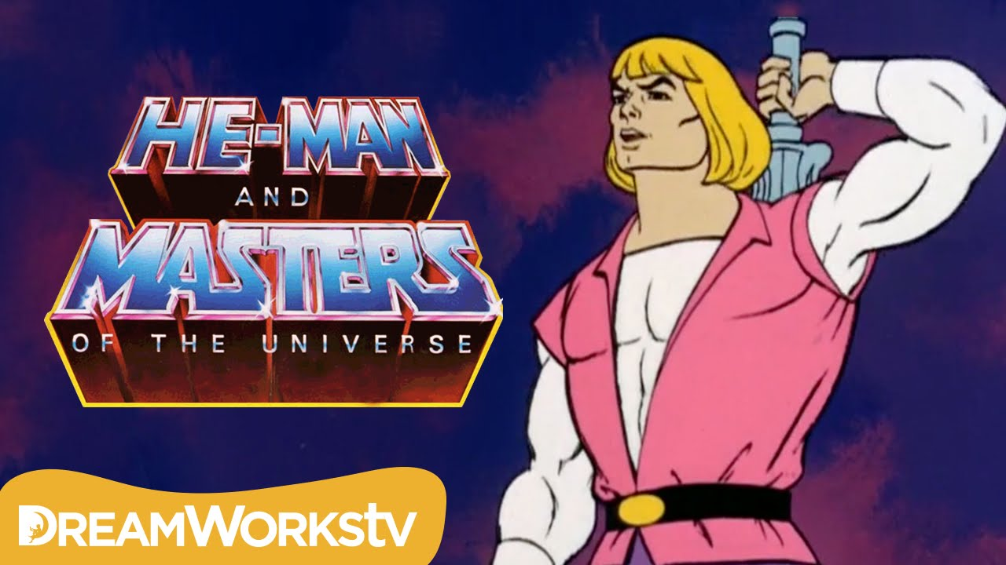

Slide 11
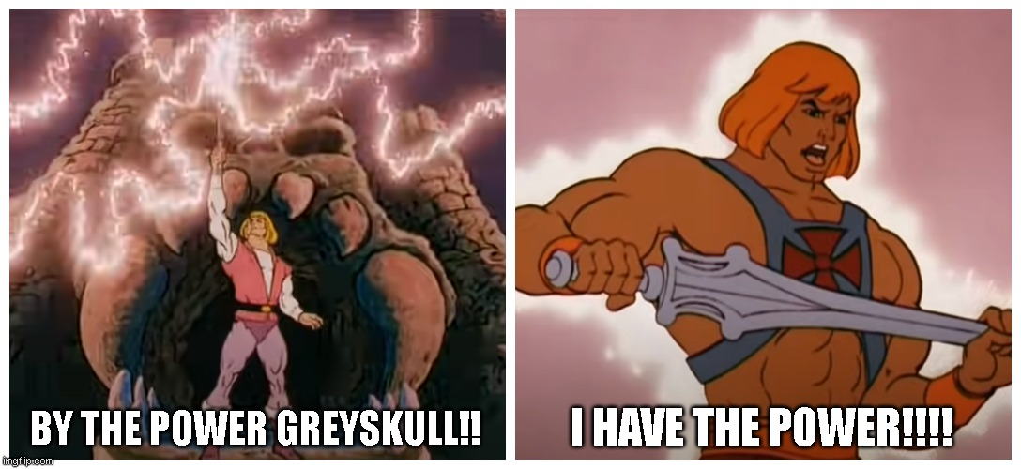

Slide 12
“The real power did not come from Prince Adam himself, but from being connected to a power greater than himself.”

Slide 13
“Likewise, as Christians, we are not meant to rely on our own strength or wisdom to live victoriously, but on God’s power and guidance.”

Slide 14
For Personal Reflection:
Think about an area of your life where you’ve been trying to handle things on your own. Will you bring it before God and pray for His power and guidance?

Slide 15
Joshua 5:1
¹ Now when all the Amorite kings west of the Jordan and all the Canaanite kings along the coast heard how the Lord had dried up the Jordan before the Israelites until they had crossed over, their hearts melted in fear and they no longer had the courage to face the Israelites.

Slide 16
Joshua 5:2-5
² At that time the Lord said to Joshua, “Make flint knives and circumcise the Israelites again.”
³ So Joshua made flint knives and circumcised the Israelites at Gibeath Haaraloth. ⁴ Now this is why he did so: All those who came out of Egypt—all the men of military age—died in the wilderness on the way after leaving Egypt. ⁵ All the people that came out had been circumcised, but all the people born in the wilderness during the journey from Egypt had not.

Slide 17
For Modern Circumcision Surgery:
“Circumcision recovery typically takes 2-3 weeks for initial healing, though complete healing can take up to 6 weeks.”
(Source taken from website of TAF Clinic – Men’s Health Clinic in Singapore: https://tafclinic.com.sg/male-circumcision-recovery-timeline/)

Slide 18
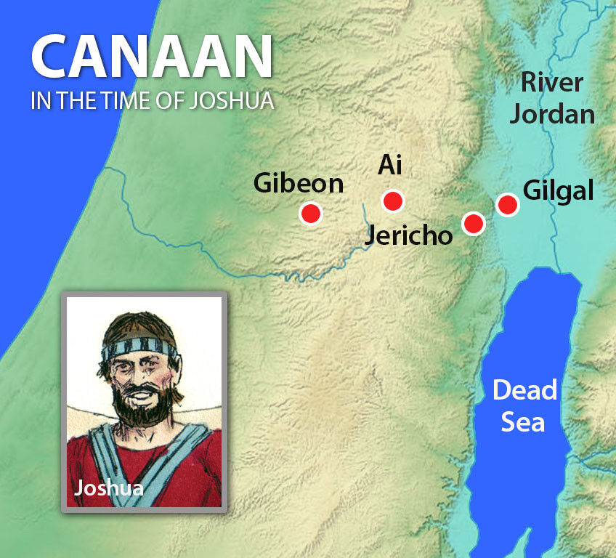


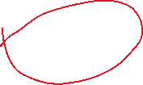

“Geographically, Jericho Was Only About 1.5–3 km Away!”

Slide 19
Joshua 5:8
⁸ And after the whole nation had been circumcised, they remained where they were in camp until they were healed.

Slide 20
Wiersbe Bible Commentary
“The triumphant conquest of the land was to be the victory of God, not the victory of Israel or of Joshua. It was neither the expertise of the Jewish army nor the emotions of the enemy that would give Israel the victory, but the presence and blessing of the Lord.”

Slide 21
For Personal Reflection:
Is there something God is asking you to trust Him with, even if it doesn’t make sense from a human perspective?

Slide 22
Online Article: “Why You Should Accept Help Even When You Think You Don’t Need It.”
In the article, the author who is a Professor of Counselling Psychology describes 3 types of people who find it difficult to accept help from others even when they need it.

Slide 23
Online Article: “Why You Should Accept Help Even When You Think You Don’t Need It.”
1. Hyper-Independence:
“You avoid depending on anyone, and you have few meaningful relationships… Vulnerability terrifies you. Asking for help feels impossible.”
(Source taken from: https://www.psychologytoday.com/us/blog/gratefully/202601/the-5-ways-we-lean-on-others-or-dont)

Slide 24
Online Article: “Why You Should Accept Help Even When You Think You Don’t Need It.”
2. Caretakerism:
“You’re great at giving, terrible at receiving. You form meaningful relationships by helping others…but resist the thought of being cared for yourself.”
(Source taken from: https://www.psychologytoday.com/us/blog/gratefully/202601/the-5-ways-we-lean-on-others-or-dont)

Slide 25
Online Article: “Why You Should Accept Help Even When You Think You Don’t Need It.”
3. Stigmatized Dependence:
“You do rely on others, but you feel ashamed of it. Maybe you’ve internalized the idea that needing people equals weakness. Instead of leaning in, you hide your needs or apologize for them.”
(Source taken from: https://www.psychologytoday.com/us/blog/gratefully/202601/the-5-ways-we-lean-on-others-or-dont)

Slide 26
“Just as the Israelites relied on God’s power and guidance to conquer the Promised Land, we too are called to depend on God to live a victorious life here on earth.”

Slide 27
(1) The Need to Restore and Renew Our Relationship with God
Just as God did with the Israelites at Gilgal, He sometimes asks us to pause, obey, and be renewed in our relationship with Him, before we can experience breakthrough in our lives.
The secret is not in how we pray, fast, or worship God it’s about restoring and renewing our relationship with Him, just as the Israelites did in obedience through circumcision.

Slide 28
Joshua 5:9-10
⁹ Then the Lord said to Joshua, “Today I have rolled away the reproach of Egypt from you.” So the place has been called Gilgal to this day.
¹⁰ On the evening of the fourteenth day of the month, while camped at Gilgal on the plains of Jericho, the Israelites celebrated the Passover.

Slide 29
Romans 2:28-29
²⁸ A person is not a Jew who is one only outwardly, nor is circumcision merely outward and physical. ²⁹ No, a person is a Jew who is one inwardly; and circumcision is circumcision of the heart, by the Spirit, not by the written code. Such a person’s praise is not from other people, but from God.

Slide 30
For Personal Reflection:
Are you simply going through outward religious actions, or is your heart truly devoted to God in love and obedience?

Slide 31
(2) The Need to Surrender to God, Not Just Ask Him to Bless Our Plans
Sometimes, even with the best plans and strategies, God asks us to surrender completely to His will and authority, rather than depending on our own understanding.

Slide 32
Joshua 5:13-15
¹³ Now when Joshua was near Jericho, he looked up and saw a man standing in front of him with a drawn sword in his hand. Joshua went up to him and asked, “Are you for us or for our enemies?”
¹⁴ “Neither,” he replied, “but as commander of the army of the Lord I have now come.” Then Joshua fell facedown to the ground in reverence, and asked him, “What message does my Lord have for his servant?”
¹⁵ The commander of the Lord’s army replied, “Take off your sandals, for the place where you are standing is holy.” And Joshua did so.

Slide 33
Proverbs 3:5-6
⁵ Trust in the Lord with all your heart and lean not on your own understanding; ⁶ in all your ways submit to him, and he will make your paths straight.

Slide 34
For Personal Reflection:
Is there an area of your life where you’ve been “rowing against the wind” by relying on your own plans and understanding? Will you surrender that situation to God, trust His authority, and follow His leading?

Slide 35
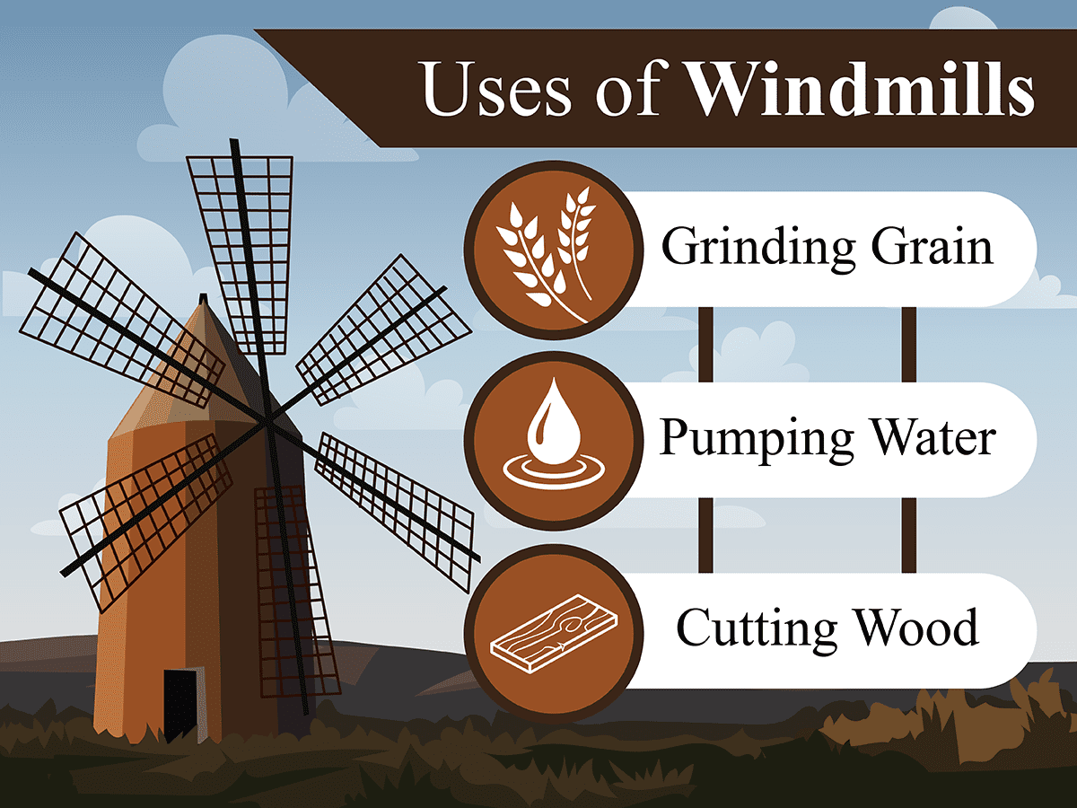
Conclusion:

Slide 36
A windmill does not create the wind. It does not control the direction or the strength of the wind either.
Its role is simply to be positioned correctly. And when the wind comes, the windmill turns not by its own strength, but by the power of the wind.

Slide 37
God’s power and guidance are like the wind that turns a windmill and we, needless to say, are like the windmill.
Just like a windmill which must be rightly positioned to catch the wind, we need to be aligned with God before His power and guidance could move through us.

Slide 38
Likewise, God’s power and guidance are not something (that) we can control or manipulate. We cannot simply “switch it on” when we need them.

Slide 39
It’s only when our lives are rightly positioned before God and aligned with His will through obedience and submission that we can then experience His power and guidance at work in our lives.

