Slide 1
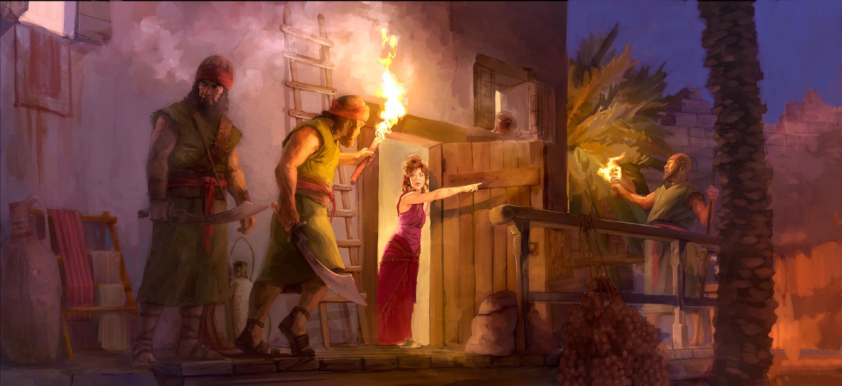
Faith from unexpected places
Joshua 2:1-24

Slide 2
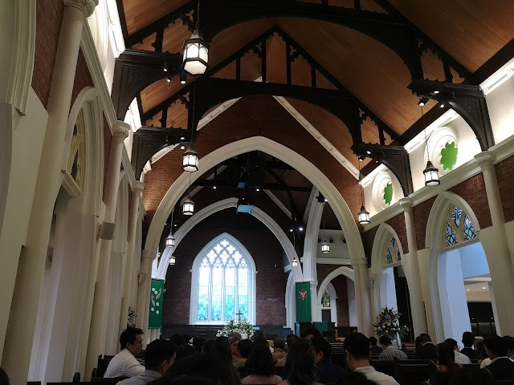

Slide 3
Context
Passing of Moses; Joshua was called by God to take over.
Joshua is the next chosen one to lead Israel into the Promised Land.

Slide 4
Context
Israel numbered almost 2-3 million people.
Numbers 12:7-8: God had spoken to Moses face to face and had entrusted him “with all my house”. Very big shoes to fill!
Joshua: Stressed! Sense of fear?

Slide 5
God assured Joshua. Exhorting him three times to be “strong and courageous”.
With God’s assurances, Joshua then called upon Israel to prepare themselves. At that time, they were at a place call Shittim.

Slide 6
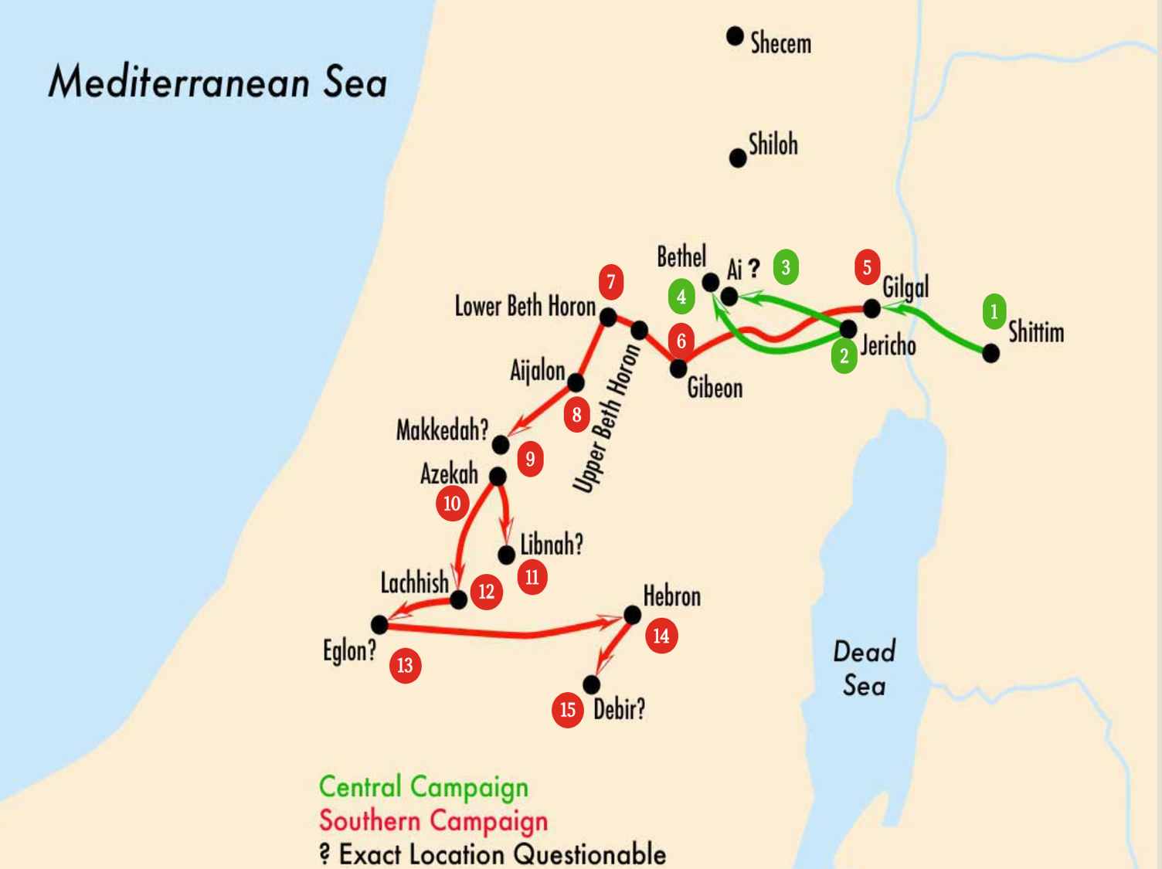

Slide 7
Within three days, Israel would be crossing the Jordan River into Jericho.
Their very first city to conquer in the Promised Land. Joshua sent spies to scout Jericho.

Slide 8
Joshua 2
2 And Joshua the son of Nun sent two men secretly from Shittim as spies, saying, “Go, view the land, especially Jericho.” And they went and came into the house of a prostitute whose name was Rahab and lodged there. ² And it was told to the king of Jericho, “Behold, men of Israel have come here tonight to search out the land.” ³ Then the king of Jericho sent to Rahab, saying, “Bring out the men who have come to you, who entered your house, for they have come to search out all the land.” ⁴ But the woman had taken the two men and hidden them. And she said, “True, the men came to me, but I did not know where they were from.

Slide 9
⁵ And when the gate was about to be closed at dark, the men went out. I do not know where the men went. Pursue them quickly, for you will overtake them.” ⁶ But she had brought them up to the roof and hid them with the stalks of flax that she had laid in order on the roof. ⁷ So the men pursued after them on the way to the Jordan as far as the fords. And the gate was shut as soon as the pursuers had gone out.⁸ Before the men lay down, she came up to them on the roof

Slide 10
⁹ and said to the men, “I know that the Lord has given you the land, and that the fear of you has fallen upon us, and that all the inhabitants of the land melt away before you. ¹⁰ For we have heard how the Lord dried up the water of the Red Sea before you when you came out of Egypt, and what you did to the two kings of the Amorites who were beyond the Jordan, to Sihon and Og, whom you devoted to destruction.^{[c]}

Slide 11
¹¹ And as soon as we heard it, our hearts melted, and there was no spirit left in any man because of you, for the Lord your God, he is God in the heavens above and on the earth beneath. ¹² Now then, please swear to me by the Lord that, as I have dealt kindly with you, you also will deal kindly with my father's house, and give me a sure sign

Slide 12
¹³ that you will save alive my father and mother, my brothers and sisters, and all who belong to them, and deliver our lives from death.” ¹⁴ And the men said to her, “Our life for yours even to death! If you do not tell this business of ours, then when the Lord gives us the land we will deal kindly and faithfully with you.”

Slide 13
¹⁵ Then she let them down by a rope through the window, for her house was built into the city wall, so that she lived in the wall. ¹⁶ And she said to them, “Go into the hills, or the pursuers will encounter you, and hide there three days until the pursuers have returned. Then afterward you may go your way.”

Slide 14
¹⁷ The men said to her, “We will be guiltless with respect to this oath of yours that you have made us swear. ¹⁸ Behold, when we come into the land, you shall tie this scarlet cord in the window through which you let us down, and you shall gather into your house your father and mother, your brothers, and all your father's household.

Slide 15
¹⁹ Then if anyone goes out of the doors of your house into the street, his blood shall be on his own head, and we shall be guiltless. But if a hand is laid on anyone who is with you in the house, his blood shall be on our head. ²⁰ But if you tell this business of ours, then we shall be guiltless with respect to your oath that you have made us swear.” ²¹ And she said, “According to your words, so be it.” Then she sent them away, and they departed. And she tied the scarlet cord in the window.

Slide 16
²² They departed and went into the hills and remained there three days until the pursuers returned, and the pursuers searched all along the way and found nothing. ²³ Then the two men returned. They came down from the hills and passed over and came to Joshua the son of Nun, and they told him all that had happened to them. ²⁴ And they said to Joshua, “Truly the Lord has given all the land into our hands. And also, all the inhabitants of the land melt away because of us.”

Slide 17
  Three major set of characters, one God
  Joshua the (isolated) leader
  Two (unknown) spies
  Rahab the (outcast)
  The (unseen) God

Slide 18
Joshua the isolated leader
Joshua was suddenly left all alone to lead the 2-3 million Israelites into the Promised Land.
A much bigger project than us trying to seek out a new worship space in six years time.
Joshua was full of faith. He strongly believe that the time had come for Israel to finally have their resting place.

Slide 19
Joshua did not send the twelve spies.
Twelve spies included both Joshua and Caleb, were tribal chiefs.
Joshua sent only two.

Slide 20
The two spies were sent not to see if the land of Jericho was for the taking.
Instead, the spying was part of Joshua’s strategy to see how they can conquer Jericho in the best way.

Slide 21
Joshua did it. Not with his own strength or wisdom; but with the reliance on God’s assurance that He will be with him always.
Joshua relied not so much on how he felt about his external circumstances. He relied on the word of God. If God said it, it would come to pass.

Slide 22
What can we learn from Joshua, the son of Nun?
As we continue to explore options for the future worship space of Agape; let us rise to the faith of Joshua.
Let us heed the call of God for us to to stay in Jurong. Let us be strong and courageous.

Slide 23
There is a promised land for Agape.
We have moved from the living room of a home to a bomb shelter, to a void deck, to a cinema and finally to this place.

Slide 24
Though we move from place to place, God had always provided for us.
He had even added to our numbers. We have a God who is immovable. We have a God whom we can rely on.
We have a God who have impressed upon many of our hearts to stay in Jurong. The “Promised Land”, is ours to conquer!

Slide 25
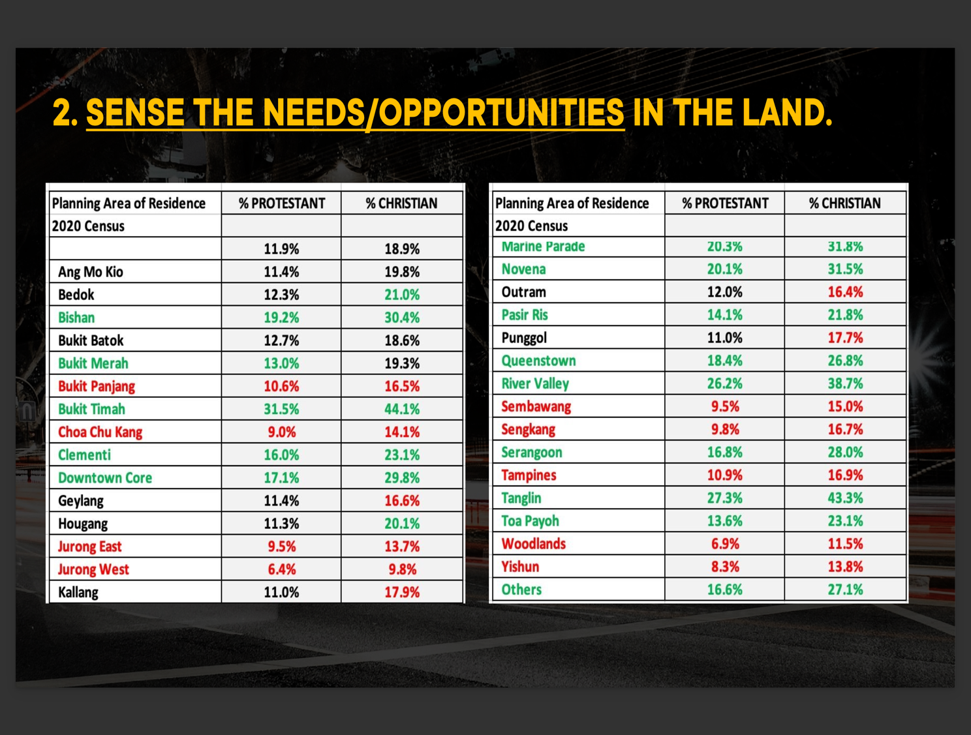

Slide 26
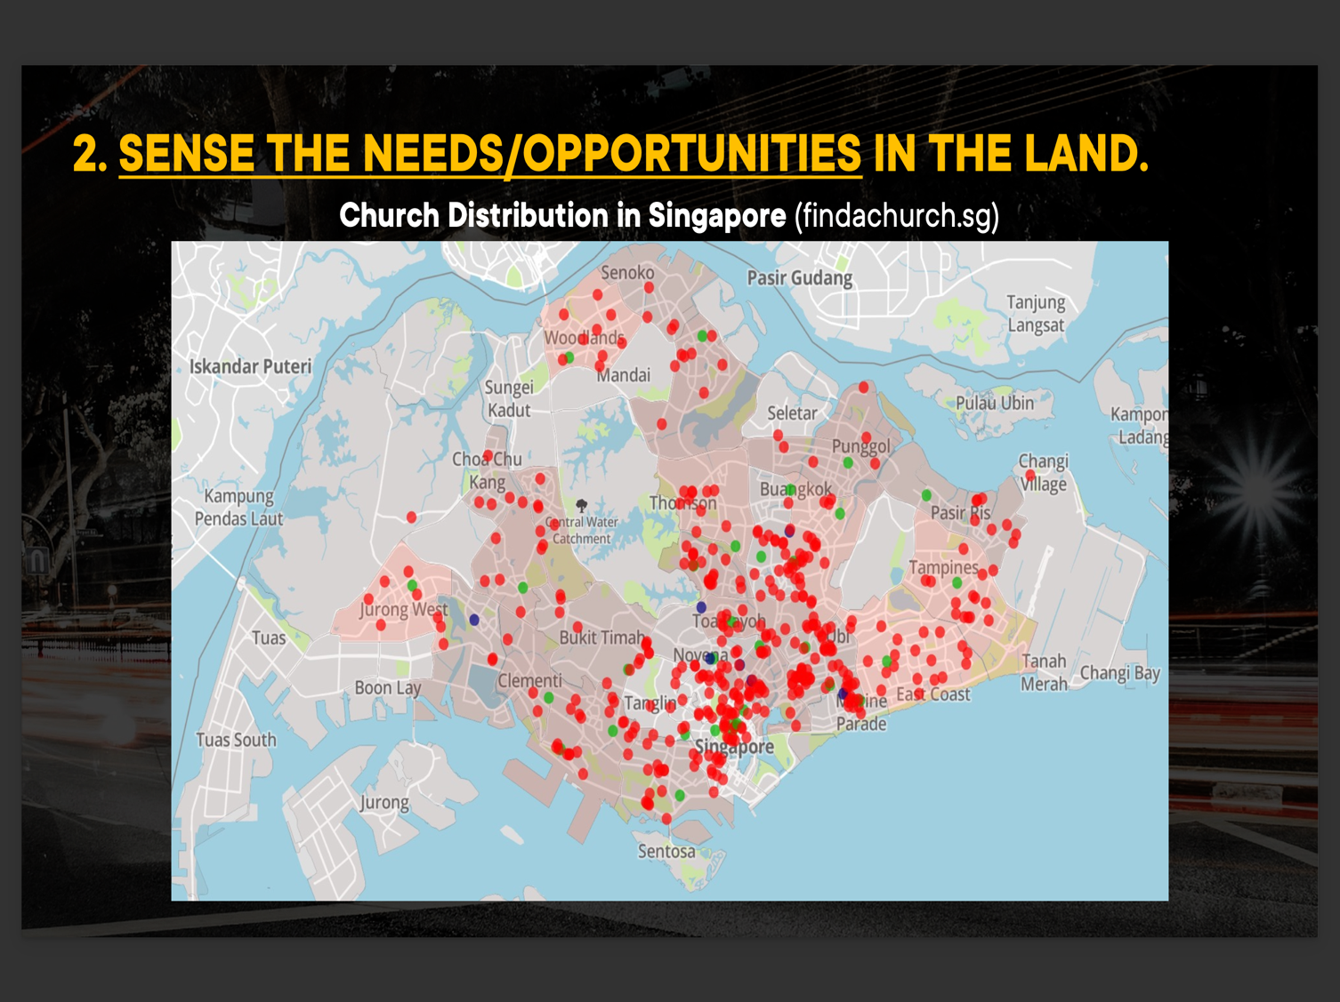

Slide 27
The two unknown spies
The author of the book of Joshua, made an intentional contrast between the 12 tribal chiefs sent for the first scouting expedition; and the two unknown men sent for the second expedition.

Slide 28
First expedition failed miserably, though it was sent with some grandeur.
In contrast, it was the second expedition, the lesser known, the one sent in “secret” that ended up with success.

Slide 29
Despite being unknown, the faith of the two spies were comparable to that of Caleb and Joshua.
Even if only a small team of two persons, they risked their life in a land where they could get caught and killed at any time.

Slide 30
Yet, they were full of faith that God had anointed Joshua and if Joshua sent them, they go.
Furthermore, when they returned to Shittim. They reported to Joshua: “Truly the Lord has given all the land into our hands. And also, all the inhabitants of the land melt away because of us.”

Slide 31
What can we learn from the two unknown spies?
The two spies might be unknown to us, but God knows exactly who they were.
Though they were not as well known as the tribal chiefs; God used them mightily to influence an important part of Israel’s history.

Slide 32
The two spies reminded that even if the whole world do not know who you are. God knows and He calls you to do His work. When He calls, He will also enable n protect you.
Your current vocation and place where you are working is not by chance. God allowed it. In some cases, God called for it. What matters most is despite being unknown, what do we do with God’s assignment in our hands?

Slide 33
Rahab the outcast
In ancient times, Rahab would have been being considered by the society, to be the lowest of the low.
This was why Rahab had to stay at the city gates. Some distance away from where the more “dignified” people were.

Slide 34
Yet, despite her profession, this is a woman of faith.
Rahab had not seen God at work at the Red Sea or when the Kings of Amorites were destroyed.
Yet, when she heard of what God had done, she believed.

Slide 35
Romans 10:17 - “faith comes from hearing and hearing through the word of Christ”.
Rahab might not have heard the Gospel, but when she heard of the glory of God, she believed.
For this, she was counted to be among the Hall of Faith.

Slide 36
Rahab’s faith is not a superficial one. She acted upon her faith by:
  Hiding the spies
  Sending King Jericho’s servants to the wrong place
  Asking for Israel to spare her and family’s lives when they come into Jericho.

Slide 37
This “working-faith” was contrasted with the rest of Jericho’s inhabitants.
The Apostle James would have said that the ”faith” of the people of Jericho was without works. It is dead.

Slide 38
What can we learn?
No matter how “messy” we seem to be to the world, God looks at us differently.
If we are willing to repent and embrace Him as the Lord of our lives, He is willing to save, and His grace abounds.
When Jericho falls, Rahab was invited to stay with Israel and she even married into the tribe of Judah and was part of Jesus’ genealogy.

Slide 39
The other thing to learn is that we need to ask God to help us see people as He sees them.
We do not look down on anyone but be open to encounter Jesus through them.

Slide 40
When we collaborate with others for ministry, let us look beyond the titles, personalities or even deeds.
If God can use Rahab the prostitute and the two unknown spies; He can use many people with similar or even worse backgrounds to do His mighty works.

Slide 41
The unseen God
While the Rahab narrative is filled with interesting characters and their extraordinary demonstration of faith; we can see the hand of God in every peak moment of the story.
Indeed, God’s faithfulness permeates throughout the story.

Slide 42
We all know that God is faithful.
Yet, how do we usually respond to God’s faithfulness in our lives? The faithfulness of an unseen and invisible God?
Do we respond in faith and obedience, or have we taken God for granted and being calculative even with God?

Slide 43
For Joshua, Rahab and the two spies, they responded in “working faith” towards the great faithfulness of God in their lives.

Slide 44
If you believe that God has been faithful to you as a believer or even before you become a believer, what would be one of your actionable faith today?

Slide 45
Conclusion
The road to the Promised Land was indeed a great journey of faith.
Yet, the legacy of Joshua and the generation of people who settled in the Promised Land lasted only 300-400 years.
After Joshua, the Promised Land plunged into the days of the Judges, Kings, foreign powers and finally the demise of a great empire that allowed herself to sink into a throve of idolatry and sin.

Slide 46
It took the faithfulness of God again to send forth His Son.
This time, the fulfilment of His promise gives rise to the death of Jesus, but permanence of salvation to those who believe.
We can never outdo or even seek to repay God’s patience, mercy and faithfulness in our lives.

Slide 47
What we can do is that like Joshua, the two spies and Rahab, we want to be faithful to carry out God’s will in our lives.
Seek God in ways we can. Follow Him in ways we should and love people in ways He had ordained.

Slide 48
Discussion questions
Joshua 2:1-24
Why was Joshua so full of faith that God was going to give Israel the Promised Land?
Why did Joshua send out only two unknown spies (in the 2nd expedition) while Moses was told to send out 12 tribal chiefs in the first expedition?
Was there a time when you exhibited faith like Joshua or perhaps failed to do so? Tell the story to one another. How did God respond to what you have done or failed to do?
Do you recall people you have met or in your own community that are largely “unknown” but faithful? How have their faithfulness impact the people / you?
Before hearing the sermon, would you expect to find faith and the glory of God in the red-light districts of Singapore? Why or why not?
What do you think is God’s promise / will for your life? How has that been going?

