Slide 1


How do you hear?
Matthew 13:1-23

Slide 2
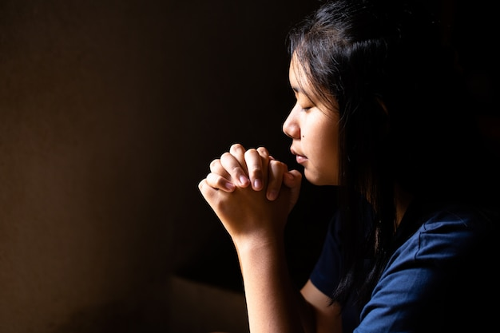
“Let us close our eyes and come to the Lord in prayer”.

Slide 3
Three big lessons:
  When we teach, know our audience and be sensitive to their needs.
  Some of God’s children do not hear the word as we do. They “hear” with their eyes and for some, even with touches.
  If I have healthy ears, what do I use them for? How do I hear the word?

Slide 4
Apparently, Jesus found it extremely important that we hear the word in a way that is pleasing to God.
So much so that God anointed three out of four Gospel writers to record a parable that teach us the importance of “hearing”:

Slide 5
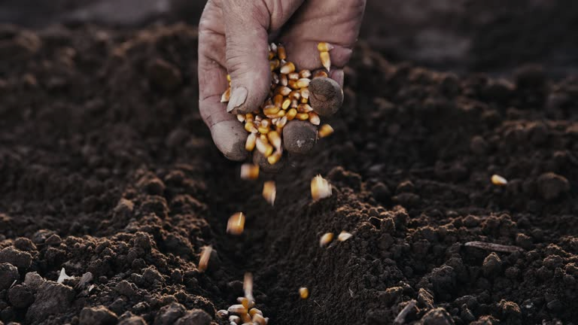
Parable of the Sower
Matthew 13:1-23
Mark 4:1-20
Luke 8:4-15

Slide 6
Matthew 13:1-23
13 That same day Jesus went out of the house and sat beside the sea. ² And great crowds gathered about him, so that he got into a boat and sat down. And the whole crowd stood on the beach. ³ And he told them many things in parables, saying: “A sower went out to sow. ⁴ And as he sowed, some seeds fell along the path, and the birds came and devoured them.

Slide 7
⁵ Other seeds fell on rocky ground, where they did not have much soil, and immediately they sprang up, since they had no depth of soil, ⁶ but when the sun rose they were scorched. And since they had no root, they withered away. ⁷ Other seeds fell among thorns, and the thorns grew up and choked them. ⁸ Other seeds fell on good soil and produced grain, some a hundredfold, some sixty, some thirty. ⁹ He who has ears, let him hear.”

Slide 8
¹⁰ Then the disciples came and said to him, “Why do you speak to them in parables?” ¹¹ And he answered them, “To you it has been given to know the secrets of the kingdom of heaven, but to them it has not been given. ¹² For to the one who has, more will be given, and he will have an abundance, but from the one who has not, even what he has will be taken away. ¹³ This is why I speak to them in parables, because seeing they do not see, and hearing they do not hear, nor do they understand.

Slide 9
¹⁴ Indeed, in their case the prophecy of Isaiah (Isaiah 6:9-10) is fulfilled that says:
“You will indeed hear but never understand,
and you will indeed see but never perceive.”
¹⁵ For this people's heart has grown dull,
and with their ears they can barely hear,
and their eyes they have closed,
lest they should see with their eyes
and hear with their ears
and understand with their heart
and turn, and I would heal them.’

Slide 10
¹⁶ But blessed are your eyes, for they see, and your ears, for they hear. ¹⁷ For truly, I say to you, many prophets and righteous people longed to see what you see, and did not see it, and to hear what you hear, and did not hear it.

Slide 11
¹⁸ “Hear then the parable of the sower: ¹⁹ When anyone hears the word of the kingdom and does not understand it, the evil one comes and snatches away what has been sown in his heart. This is what was sown along the path. ²⁰ As for what was sown on rocky ground, this is the one who hears the word and immediately receives it with joy, ²¹ yet he has no root in himself, but endures for a while, and when tribulation or persecution arises on account of the word, immediately he falls away.

Slide 12
²² As for what was sown among thorns, this is the one who hears the word, but the cares of the world and the deceitfulness of riches choke the word, and it proves unfruitful. ²³ As for what was sown on good soil, this is the one who hears the word and understands it. He indeed bears fruit and yields, in one case a hundredfold, in another sixty, and in another thirty.”
Word of the Lord!

Slide 13
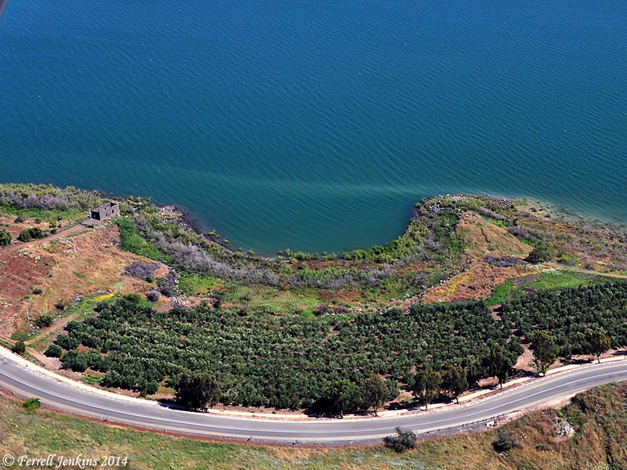
Cove of the Sower

Slide 14
Outline
What are parables and how did Jesus use them for His purpose?
Why did Jesus tell the crowd about the Parable of the Sower?
What did Jesus want the disciples (us) to learn and do about the Parable of the Sower?

Slide 15
What are parables?
In the Gospels, parables are stories or illustrations used by Jesus to teach.
Parables can be found in the Gospels of Luke, Mark and Matthew.

Slide 16
What are parables?
Parables were told because through them, Jesus reveal the truth about God’s kingdom to those who were seeking.
At the same time, it concealed the truth from those who were hard-hearted or choose not to listen nor understand.

Slide 17
Matthew 13:15-16 / Isaiah 6:9-10
¹⁵ For this people's heart has grown dull,
and with their ears they can barely hear,
and their eyes they have closed,
lest they should see with their eyes
and hear with their ears
and understand with their heart
and turn, and I would heal them.’

Slide 18
The intent of concealing the Gospel with parables is to separate those who are sincere and those not sincere.
Those who truly seek to understand and those who do not. One side receives blessings. The other receives judgment.

Slide 19
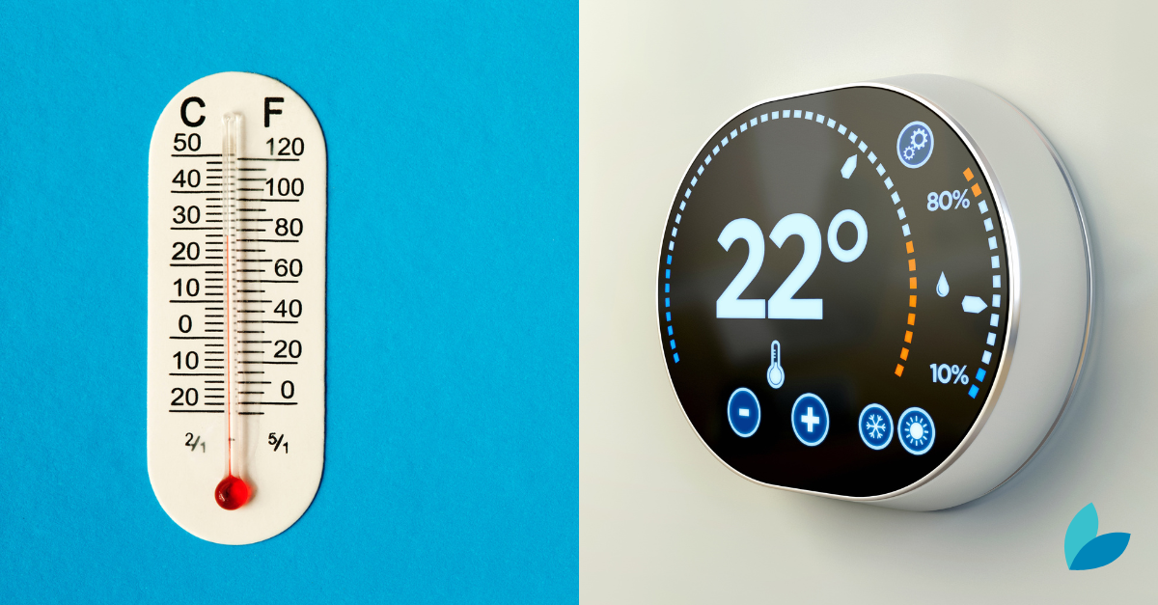
Someone said that Jesus’ parables works more like a thermometer than a thermostat. Parables expose a person’s spiritual condition rather than determine it.

Slide 20
Knowing God and growing in the faith is a gradual process.
Jesus’ parables serve the purpose of revealing to the Christian that faith is about a whole lifetime spent discovering and rediscovering the simple yet profound nature of the kingdom of God.

Slide 21
Therefore, in Matthew 13:16, Jesus emphasized to the disciples that:
¹⁶ But blessed are your eyes, for they see, and your ears, for they hear. ¹⁷ For truly, I say to you, many prophets and righteous people longed to see what you see, and did not see it, and to hear what you hear, and did not hear it.

Slide 22
The disciples were blessed!
We are blessed! Because we believe when we have not seen; but heard through the preaching of the word!

Slide 23
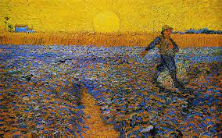
Jesus then went on to further explain the faithful hearing of God’s word by explaining the Parable of the Sower:

Slide 24
In the parable, we are told that seeds fell on four types of environment, which equates to four types of heart condition:
Along the path = Hardened heart
Rocky ground = Shallow heart
Among thorns = Distracted heart
Good soil = Sincere (Transformed) heart

Slide 25
Seeds along the path
Parable: “A sower went out to sow. ⁴ And as he sowed, some seeds fell along the path, and the birds came and devoured them.
Jesus’ Explanation: “¹⁹ When anyone hears the word of the kingdom and does not understand it, the evil one comes and snatches away what has been sown in his heart. This is what was sown along the path.”

Slide 26
Sower and seed?
The seed is the word of God.
The parable did not differentiate between believers and non-believers.
The sower is anyone who sow the word of God.

Slide 27
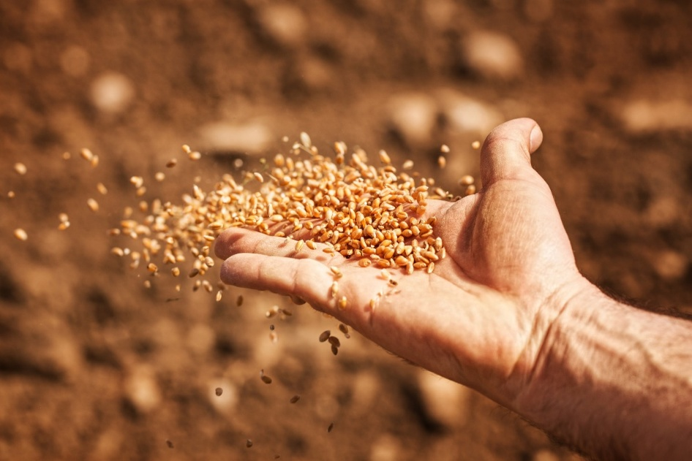
Sower and seed?
The sower was not a “careless” farmer.
During Jesus’ time, fertile lands were not separated by fences but marked by stones. Often, footpaths could even cut across these lands.

Slide 28
Seeds along the path
A situation where the word of God is rejected or that it failed to somehow penetrate the heart.
“did not understand” does not mean ignorance (as in I do not know), but intentional rejection or the failure to grasp the spiritual meaning of the word.

Slide 29
Seeds along the path
Those who reject the word or allow the word to slip them by, will have the word snatched from their heart.
This group of persons have a hardened heart towards the word.

Slide 30
Seeds along the path
How do we apply?
The hardened heart illustration refers to those who are not believers or even some who fell from the faith.
There will be persons in our circles of relationships who will have hardened hearts towards the Gospel.

Slide 31
Seeds along the path
Application
Based on the parable, even Jesus did not get a 100% response rate.
So, we need not be too discouraged when some reject the Gospel or even slam the door at us.

Slide 32
Seeds along the path
Application
What we should be focusing on is to stay faithful, pray all we can, share the Gospel with as many as we can, try all the ways we can. just as the sower scatter the seeds all over the field.
Who knows, some might just yield to the work of the Holy Spirit at the very end.

Slide 33
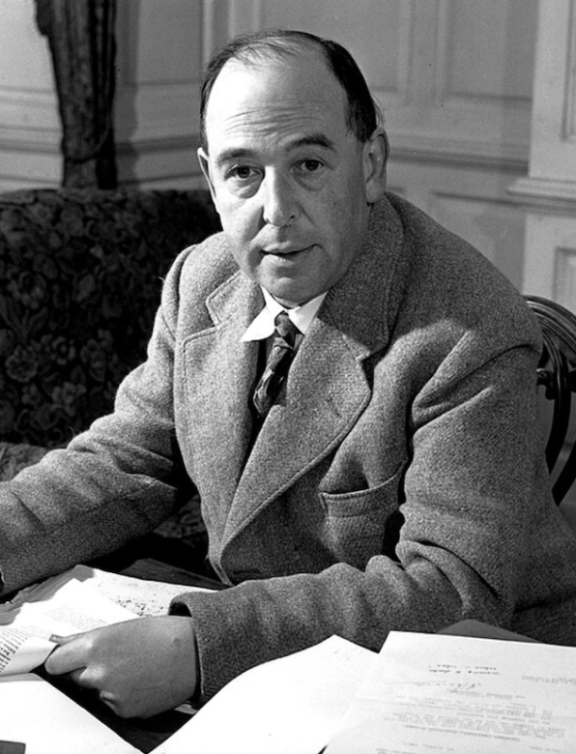
Seeds along the path
Application
As Stacey shared the last sermon, we might get three kinds of surprise when we are finally with God in the new heavens and new earth.

Slide 34
Seeds on rocky ground
Parable: “⁵ Other seeds fell on rocky ground, where they did not have much soil, and immediately they sprang up, since they had no depth of soil, ⁶ but when the sun rose they were scorched. And since they had no root, they withered away.”
Jesus’ Explanation: “²⁰ As for what was sown on rocky ground, this is the one who hears the word and immediately receives it with joy, ²¹ yet he has no root in himself, but endures for a while, and when tribulation or persecution arises on account of the word, immediately he falls away.”

Slide 35
Seeds on rocky ground
A situation where those who hear the word receives it hastily with joy.
However, because they received it without sincere faith; their joy was short lived.
When the trials of life and demands of being a disciple kicks in, they chose to flee.

Slide 36
Seeds on rocky ground
Jesus could be referring to the many who followed Him because of His teachings and miracles.
When the teachings get tough or when Jesus’ version of the kingdom of God did not fit their expectations, many stopped following Him.
They were persons with a shallow heart condition for the word of truth.

Slide 37
How can we apply?
Having a shallow heart condition is a common ailment among those who seem to believe.
They are “believers” who like the idea of being being a Christian.

Slide 38
How can we apply?
However, they want all these without being part of the Great Commission.
So, when sufferings and persecutions hit home, they got confused, angry and disappointed. Jesus said, for these, they will not inherit the kingdom.

Slide 39
Easy believism is not the Gospel that Jesus revealed when he comes into our world.
It is church attendance without community, it is community without discipleship. It is discipleship without transformation. Ultimately, it is the “Gospel” without the Cross.
Easy believism can get one through the wrong door and end up not entering the right one.

Slide 40
To protect ourselves from having a shallow heart condition, we need to allow our heart to be transformed.
If we are truly born again, we need to embrace the Gospel as it is.
We need to seek to understand the Bible as a whole and not cherry pick or hear what we only want to hear. Amen?

Slide 41
Seeds among the thorns
Parable: ⁷ Other seeds fell among thorns, and the thorns grew up and choked them.
Jesus’ Explanation: ²² As for what was sown among thorns, this is the one who hears the word, but the cares of the world and the deceitfulness of riches choke the word, and it proves unfruitful.

Slide 42
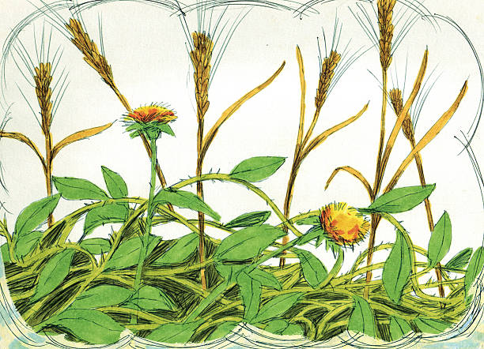
Seeds among the thorns
Seeds that fell among thorns will grow for a while. But the thorns also grow with it. Eventually, the growing seeds will be choked by the growing thorns.

Slide 43
Seeds among the thorns
This “thorny situation” illustrates believers who might be growing for while in the faith but then allow the cares and riches of this world to distract them and obstruct growth.
The word always come out unfruitful because the cares of the world is their priority.
It might even come to a situation, where they abandon the faith because they choose to prioritize the world.

Slide 44
How to apply?
Like persons without sincere faith, “believers” who subject themselves to the cares and riches of this world are increasingly common.
A research by Barna Group revealed that only 2 in 5 who called themselves “Christians” are interested in spiritual growth.

Slide 45
Application
Jesus is saying that we should not prioritize what the world offers, over and above the ways and word of God.
We should not allow the cares and riches of this world (referring to our possessions, passions and even possible promotions!) to choke our very faith!

Slide 46
Video on how English ivy can grow to choke even the most mighty of trees.

Slide 47
Seeds on good soil
Parable: ⁸ Other seeds fell on good soil and produced grain, some a hundredfold, some sixty, some thirty. ⁹ He who has ears, let him hear.”
Jesus’ Explanation: ²³ As for what was sown on good soil, this is the one who hears the word and understands it. He indeed bears fruit and yields, in one case a hundredfold, in another sixty, and in another thirty.”

Slide 48
Seeds on good soil
In those days, good soil does not just appear out of nowhere. The cultivation of good soil takes hard work.
Takes years of tiling, irrigation, fertilization and resting of the land (which God taught Israel of the 7th year Sabbatical).
Only then, when seeds fall on such good soil, do they have an opportunity to grow beautifully.

Slide 49
Seeds on good soil
Jesus explained that such well-cultivated good soil represents a kind of hearing that is connected to a heart that is humble and receptive towards the word of God.
It is a kind of hearing that “understands” (sunieis: having spiritual perception) the word and having understood, obey.

Slide 50
Seeds on good soil
Such is a sincere heart for Jesus.
The outcome of such a sincere heart is a successful spiritual harvest.
The spiritual harvest of serving King Jesus, such the joy of holy living and the multiplying of disciples who have sincere faith like you do.

Slide 51
How to apply?
Gospel is for all. Everyone can be reborn to have a heart for Christ and His word. We start by beholding Jesus.
Seek to grow as a believer. Every believer can cultivate a consistently sincere heart for Christ and His word. HOW?

Slide 52
Application
Consistent hearing of the word with sincere heart.
When we hear the word, we want to be focused and note the following:
  Don’t be too busy taking ALL the notes.
  Rather, be attentive to the leading of the Spirit in what might be important for you.
  Once you got that, make plans to apply the word for your life. Are there changes to be made? Ask God for help!
  Not every sermon will speak to you in a personal way. That’s alright! But they might be important for your neighbours?

Slide 53
How do you hear?
The hearing impaired cannot use their ears to hear the word; but they use their eyes to listen to the voice of Christ in His word.
What matters then is not the instrument by which we hear or see; what matters is that when the word gets in; what do we do with it?

Slide 54
A sharp reminder from Hebrews
^{“25} See that you do not refuse him (Jesus) who is speaking. For if they did not escape when they refused him who warned them on earth, much less will we escape if we reject him who warns from heaven.” Amen!

Slide 55
Discussion Questions
1. What is the purpose of Jesus' parables?
2. ⁠Before hearing this sermon, how have you been hearing the word of God? (through preaching, bible study, podcast etc)
3. ⁠Which of the four environments (along the path, rocky grounds, among thorns, good soil) speaks to your current situation with regard to how you hear and apply God's word? Explain your answer.
4. ⁠What must you do (or not do) in order to cultivate yourself as a good soil for hearing the word?
5. Many believers living in a city like Singapore are in a "thorny situation". Are you in a "thorny situation"? What can you do about it in order for the thorns or vines not to become too huge and strangle your faith?

