Slide 1
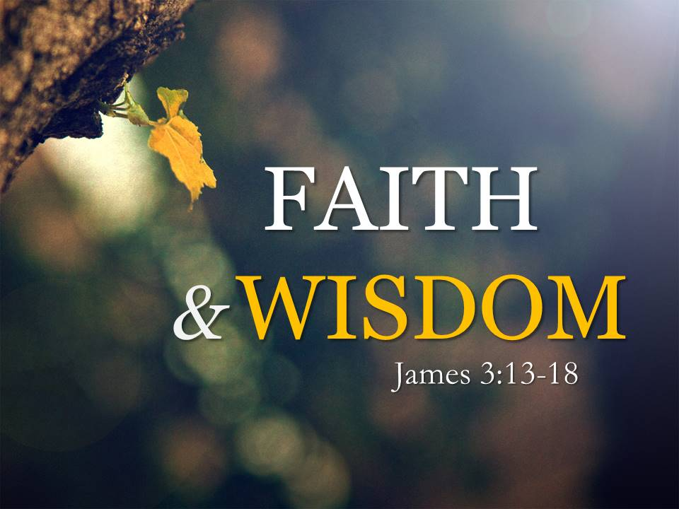

Slide 2

lll
“That's ok teacher, we have to choose what we don't have.”

Slide 3
Wisest Persons?
If someone is to ask you: “Who do you think are some of the wisest people of our time, who will you vote for?”

Slide 4
Pope Francis-for his contemplative nature, kind and open-minded leadership
Mother Teresa-for modeling a life of simplicity and love
Mahatma Gandhi-for his understanding of love, peace and forgiveness
Nelson Mandela-for using love over anger to serve his community and inspire the world
King Solomon-for recognizing that true wisdom comes from God

Slide 5
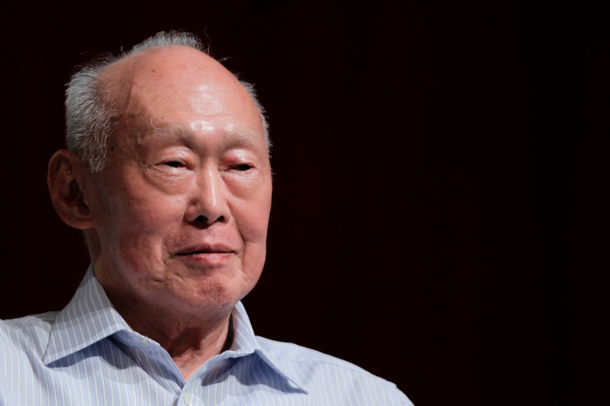

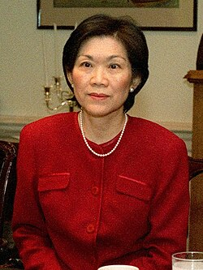
We might also include some of our own political leaders in the list.

Slide 6
It is not easy to define wisdom.
How do we determine if a form of behaviour is wisdom or deriving from intelligence?
Where does wisdom come from?

Slide 7
Who is the final authority when it comes to wisdom?
How can someone have more wisdom?
Do we even want to be wise?

Slide 8
James 1:5-8
⁵ If any of you lacks wisdom, let him ask God, who gives generously to all without reproach, and it will be given him. ⁶ But let him ask in faith, with no doubting, for the one who doubts is like a wave of the sea that is driven and tossed by the wind. ⁷ For that person must not suppose that he will receive anything from the Lord; ⁸ he is a double-minded man, unstable in all his ways.

Slide 9
James 3:13-18
¹³ Who is wise and understanding among you? By his good conduct let him show his works in the meekness of wisdom. ¹⁴ But if you have bitter jealousy and selfish ambition in your hearts, do not boast and be false to the truth. ¹⁵ This is not the wisdom that comes down from above, but is earthly, unspiritual, demonic.
¹⁶ For where jealousy and selfish ambition exist, there will be disorder and every vile practice.

Slide 10
James 3:13-18
¹³ ¹⁷ But the wisdom from above is first pure, then peaceable, gentle, open to reason, full of mercy and good fruits, impartial and sincere. ¹⁸ And a harvest of righteousness is sown in peace by those who make peace.
Word of the Lord!

Slide 11
Context
James’ immediate audience were the scattered Jewish Christians.
Due to the intensity of such persecutions, some of these Jewish Christians were discouraged, and begin to doubt the faith they had in Christ.

Slide 12
Context
James’ top concern was how worldly values had crept into the church and these values were embraced by many in the congregation.
He urged and rebuked the church to repent from these worldliness. Instead, they were to embrace Christ-like living.

Slide 13
Worldly wisdom
We read in our sermon text today, that another form of worldliness had crept into the church. It was even embraced by believers.
This form of worldliness is what the Apostle James referred to as “worldly wisdom”.

Slide 14
Worldly wisdom
In verse 15, James used three Greek adjectives to describe this kind of wisdom. He said that they are:
  Earthly (epigeios) – what belongs to the world vs what belongs to the realm of heaven (Godly).
  Unspiritual (psychikos) – Does not have the spirit of God, controlled by what is sensual / physical. Dead but walking (zombie!)
  Demonic (daimonoides) – nature of and more probably that which originates from the devil

Slide 15
Worldly wisdom is “Earthly”
Earthly (epigeios): means that which belongs to the world (vs what belongs to the realm of heaven).
This kind of wisdom tells you that the most important things in life is largely material.
It also tells you that the most important thing is to live a good life now. Don’t care about the future (YOLO!)

Slide 16
Worldly wisdom is “Earthly”
To live a good life now, earthly wisdom will tell you that wealth, material possessions and even physical experiences are “must haves” for happiness and leading a meaningful life.
Such earthly wisdom is “sold” by many corporations and even church leaders.

Slide 17


Slide 18


Slide 19
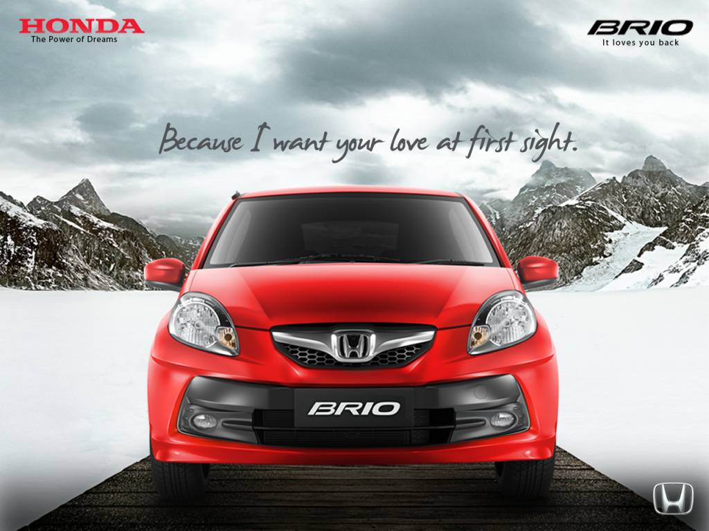

Slide 20

"Your Best Life Now" aims to empower readers to live more fully in the present by embracing a positive mindset, aligning with their faith, and making choices that lead to a more joyful and fulfilling life.

Slide 21
One Christian book review said: “The really frightening thing is that 5 million people have bought Your Best Life Now, and a good portion of those have probably walked away thinking they have read the Christian gospel. They think they understand the message of the Bible, and it is me. My success. My self-esteem. My house. My car. My promotion.” – 9Marks

Slide 22
Worldly wisdom is “unspiritual”
James also said that worldly wisdom is unspiritual.
Unspiritual (psychikos) means that this kind of wisdom does not have the spirit of God. It does not surrender to the will of God.

Slide 23
Worldly wisdom is “unspiritual”
Unspiritual wisdom is controlled by human emotions and wants. It is all about the human will. “I can do it on my own”. “Believe in yourself”. “Trust your own heart”.
It is about making decisions based on what I want, rather than what God wants.

Slide 24
As Christians, we can go on with our lives without much seeking of God. We can even sound spiritual when we are not.
The church can also be run (and “grow” like any organisation without much surrender to the Spirit of God.

Slide 25
We can also be making big decisions in the family / workplace or even in church without seeking the Most-High.
Sometimes, we might seem to be seeking God, but we are just doing what is enough for “public view”. Deep in our hearts, we do not really trust God as much as we trust ourselves.
We need to be aware of such tendencies and guard against them.

Slide 26
Worldly wisdom is demonic
James also said that worldly wisdom can be demonic (daimonoides).
Demonic because such wisdom originates from the devil and is being used to deceive the saints.
Worldly wisdom may seem good on the surface, but it leads one away from the kingdom of God. Proverbs 14:12 says: “There is a way that seems right to a man, but its end is the way to death.”

Slide 27
Example
False teachings brought by false teachers are forms of demonic wisdom.
One popular false teaching (and still widely believed) is the practice of “name it, claim it”.

Slide 28
Such a belief is not supported by the word of God. They are misinterpretations of what Jesus said for example in Mark 11:24.
Such a belief is also different from the view that we can be assured of God’s promises.

Slide 29
“Name it, claim it” originates from the 20th century Word of Faith Movement which takes reference from New Thought metaphysics and emphasize the power of spoken words.
Give rise to confusion and even guilt.

Slide 30
All these forms of worldly wisdom are characterized by and give rise to:
  Bitter jealousy,
  Selfish ambition,
  Boasting(for personal glory / gain),
  False to the truth (Rejects the truth).
They encourages disorder and every vile practice. If left uncheck, they can destroy communities.

Slide 31
Therefore, we are to identify and “kick” worldly wisdom totally out of the church and out of our lives!
That is not enough. The only way to keep worldly wisdom out of the church and our lives, is to embrace and live out Godly wisdom.

Slide 32

What is Godly wisdom or true wisdom that comes from God?

Slide 33
Godly wisdom
According to verse 13, Godly wisdom is not about what we say but it is a kind of behaviour that can be observed through good conduct and the showing of good works in meekness.
True wisdom is not a set of propositional statements; but God’s truth lived out in the real world.

Slide 34
According to verse 17, James further explained that Godly wisdom is “first pure, then peaceable, gentle, open to reason, full of mercy and good fruits, impartial and sincere”.
Quite similar to Paul’s fruit of the Spirit (Galatians 5:22-23)

Slide 35
Purity!
Purity is the overarching characteristic of true wisdom. In this context, it means moral uprightness or blamelessness.
This is aligned with Paul’s emphasis that Christians, especially leaders of the church must maintain moral blamelessness.
It is not sinless perfection (only Jesus is so); but the maintenance of a high level of moral character and conduct for the glory of God.

Slide 36
Moral blamelessness is true wisdom for it leaves little or no space for anyone to accuse you of wrong-doing.
Whether in the family, workplace or church, moral blamelessness will put us in a good place. Generally, people will trust you and that can be used by God for the Gospel.

Slide 37
Peace, Gentle, Open to reason
The next three related characteristics of true wisdom is being peaceable, gentle and open to reason.
These three characteristics are a contrast to the disorder, bitterness and conflicts caused by those who claimed to have wisdom in James’ church.

Slide 38
Being peaceable, gentle and open to reason is not a sign of weakness.
Rather, we walk in the footsteps of Jesus.
In this world of ego-maniacs and self-entitled snobs that led to wars, we can do much better, following such Godly wisdom instead.

Slide 39
As believers, we must embrace such Godly wisdom and live out them out.
The stories of Christians quarrelling with one another during leadership meetings over the most trivial matters have got to stop.

Slide 40
Mercy and good fruits
True wisdom is also full of mercy and good fruits.
According to James 2:8-13, mercy refers to the love that we show to our neighbour and that always produces good fruit for the kingdom of God.

Slide 41
Mercy and good fruits
True wisdom is therefore love in action.
Don’t just say I love you or will pray for you; show acts of kindness in a very practical way.

Slide 42
True wisdom is also impartial and sincere.
Sincerity is about showing people who we really are. Show genuine care for one another. No pretence. No showing off. If we must boast, we boast in Christ.

Slide 43
Impartiality (as explained in James 2), is not showing favorable treatment towards those who are wealthy, seemingly powerful or those whom we regard as “good friends”.
Sometimes, we defend or fail to take to task those who had done wrong because we are friendly with them. Or we give those we like more benefits

Slide 44
The church should advocate the opposite. We should learn how to show more honour and hospitality to those who are less privileged or have physical challenges.
If you are able, do something similar at your workplace. As children of God, we need to witness that the Gospel is teaching us how to live differently.

Slide 45
Fruit of righteousness
Final verse explains that true wisdom, if lived out can produce the fruit of righteousness.
The fruit of righteousness is about our Christian conduct. It is the living sacrifice (Romans 12) that is truly pleasing to God.

Slide 46
Godly wisdom is “first pure, then peaceable, gentle, open to reason, full of mercy and good fruits, impartial and sincere”.

Slide 47
If we are to make a brief contrast between the two:
Worldly wisdom emphasized what we can get for ourselves, and often with any means available.
Godly wisdom emphasised how we can be morally upright and be of blessing to others; even if it means to do it at our own expense. That is the way of Christ.

Slide 48
Reflection
Which wisdom are we seeking or embracing right now?
Worldly wisdom which seems clever, intelligent, but is earthly, unspiritual and demonic?
Or Godly wisdom which pursues peace, purity, impartiality, sincerity, gentleness, mercy, humility and open to reason?

Slide 49
If you want kick out worldly wisdom and embrace Godly wisdom, there is only one way:
James 1 says to “Ask God in faith”. Do not doubt that God can generously give you Godly wisdom. He can. He will.

Slide 50
Discussion questions
What are some examples of “worldly wisdom” you have heard or even practising? How are these different from the Godly wisdom that James was describing in James 3:13-18?
Why do you think it is easy for the church to embrace some of these worldly wisdom? What are some ways which you think can help prevent or “kick out” these worldly wisdom which James described as “earthly, unspiritual and demonic” ?
Do you like to embrace and live out Godly wisdom? Why is that and how can you do so?

